Slide 1
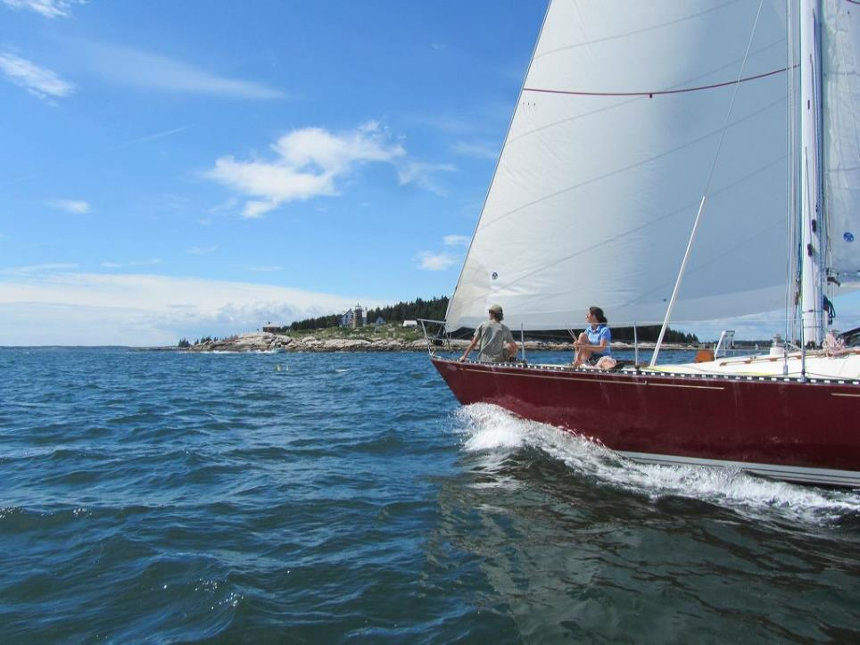
MIT Offshore Sailing Shore School
IAP 2017
Session 1

Slide 2
Course Schedule:
IAP 2017
Date | Topic
Tue Jan 10th | Introduction to Keelboats
Thurs Jan 12th | Chartering a Boat
Tue Jan 17th | Racing
Thurs Jan 19th | Navigation #1
Tue Jan 24th | Safety at Sea
Thurs Jan 26th | Navigation #2
Tue Jan 31st | Weather
Thurs Feb 2nd | Celestial Navigation

Slide 3

Agenda
Introduction
Tales of adventure
Types of boats
Boat layout
Boat systems
Life aboard
Safety Basics

Slide 4
Why We’re Here
Charter a cruise in the Virgin Islands
Sail with friends in Boston Harbor
Join a local sailing club
Buy yourself your own sailboat
Sail across the Atlantic
This is not a substitute for a certified training course like ASA 101

Slide 5
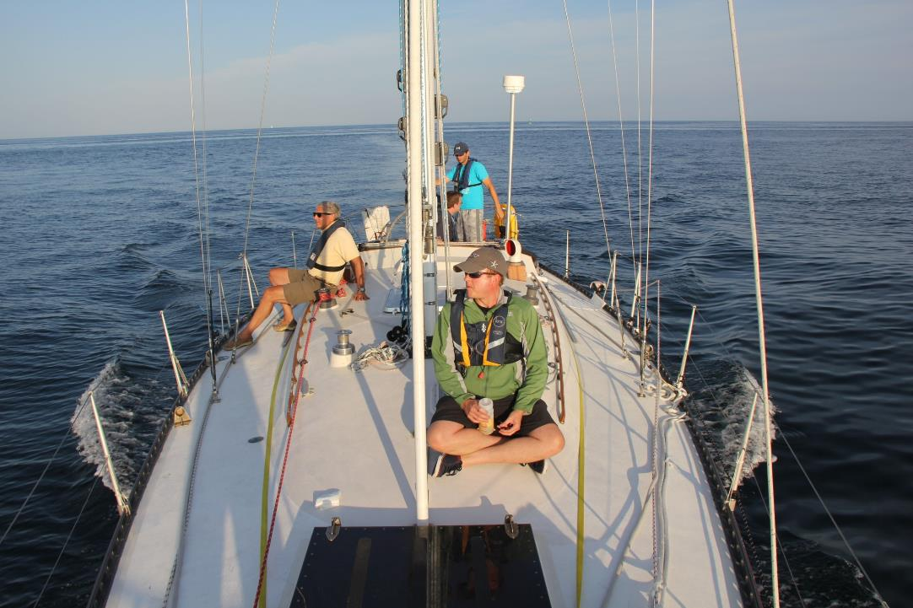

Slide 6
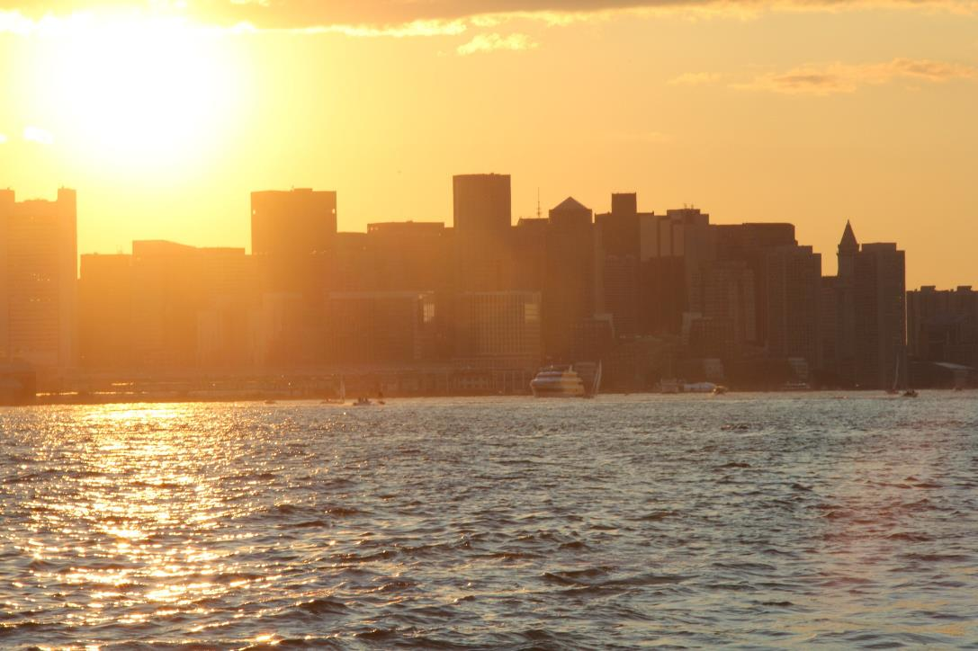

Slide 7
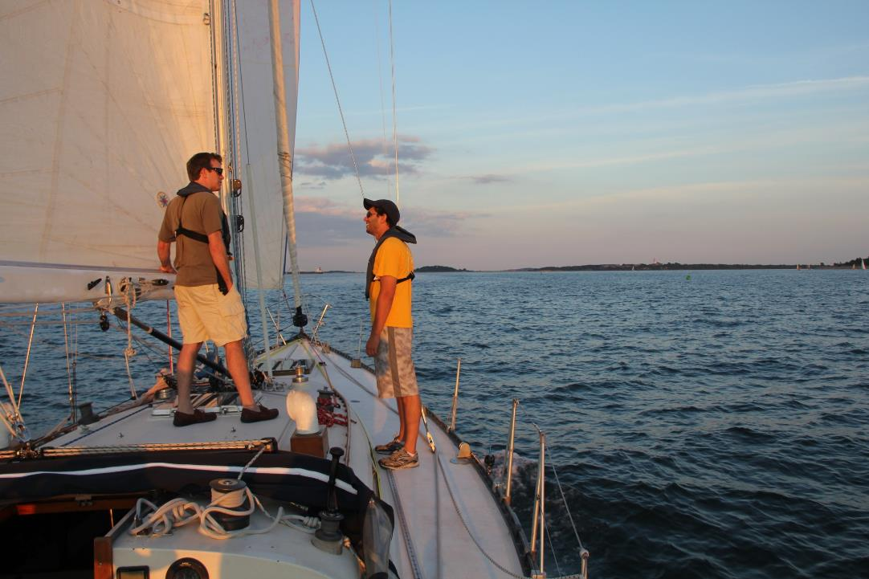

Slide 8
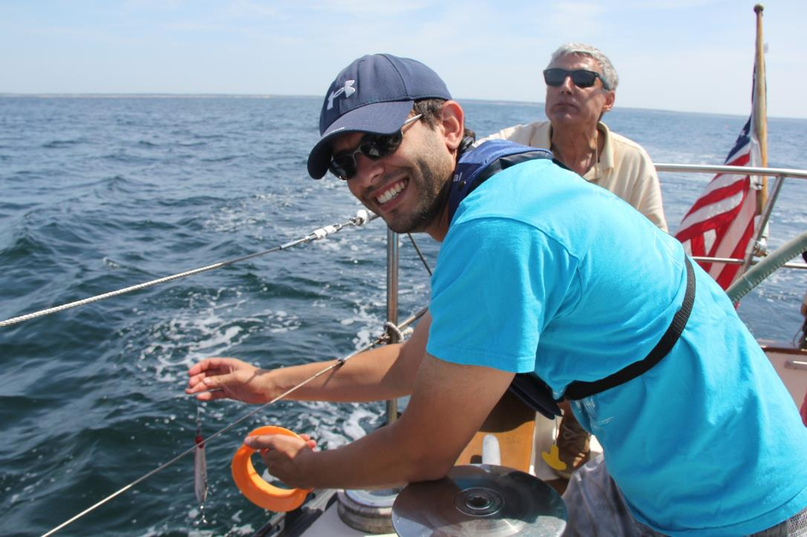

Slide 9
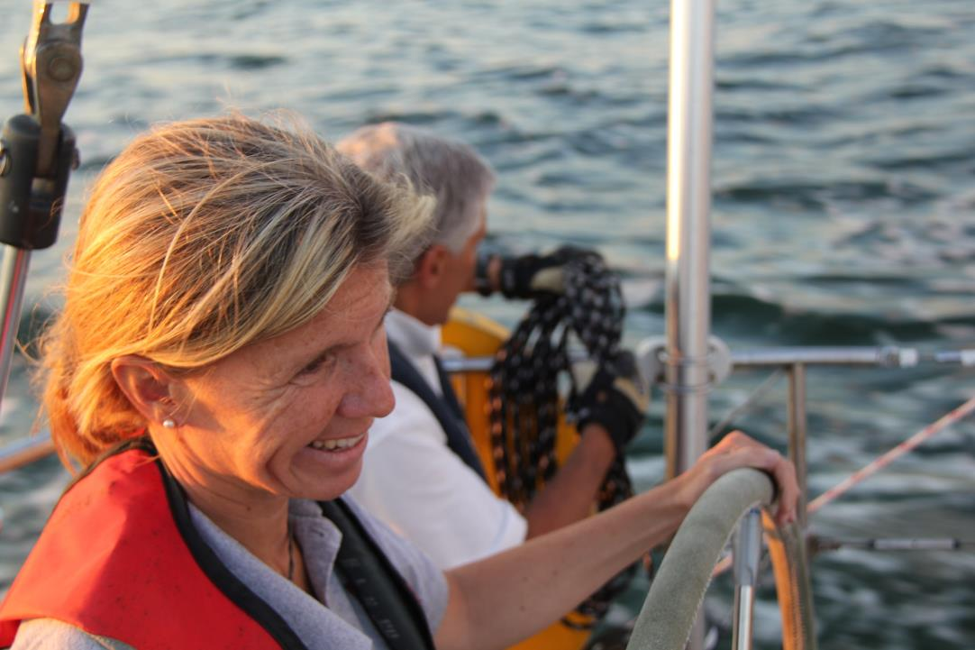

Slide 10
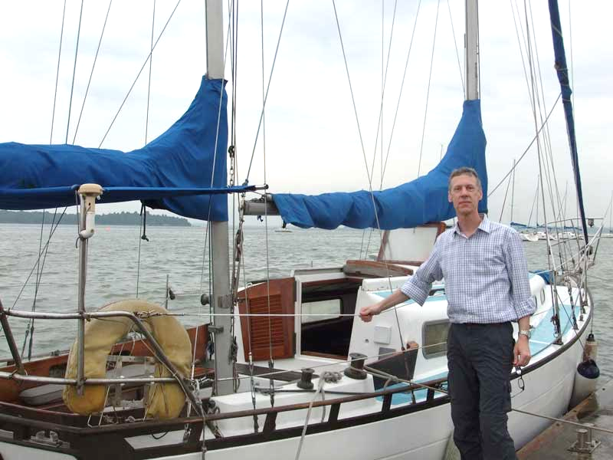

Slide 11
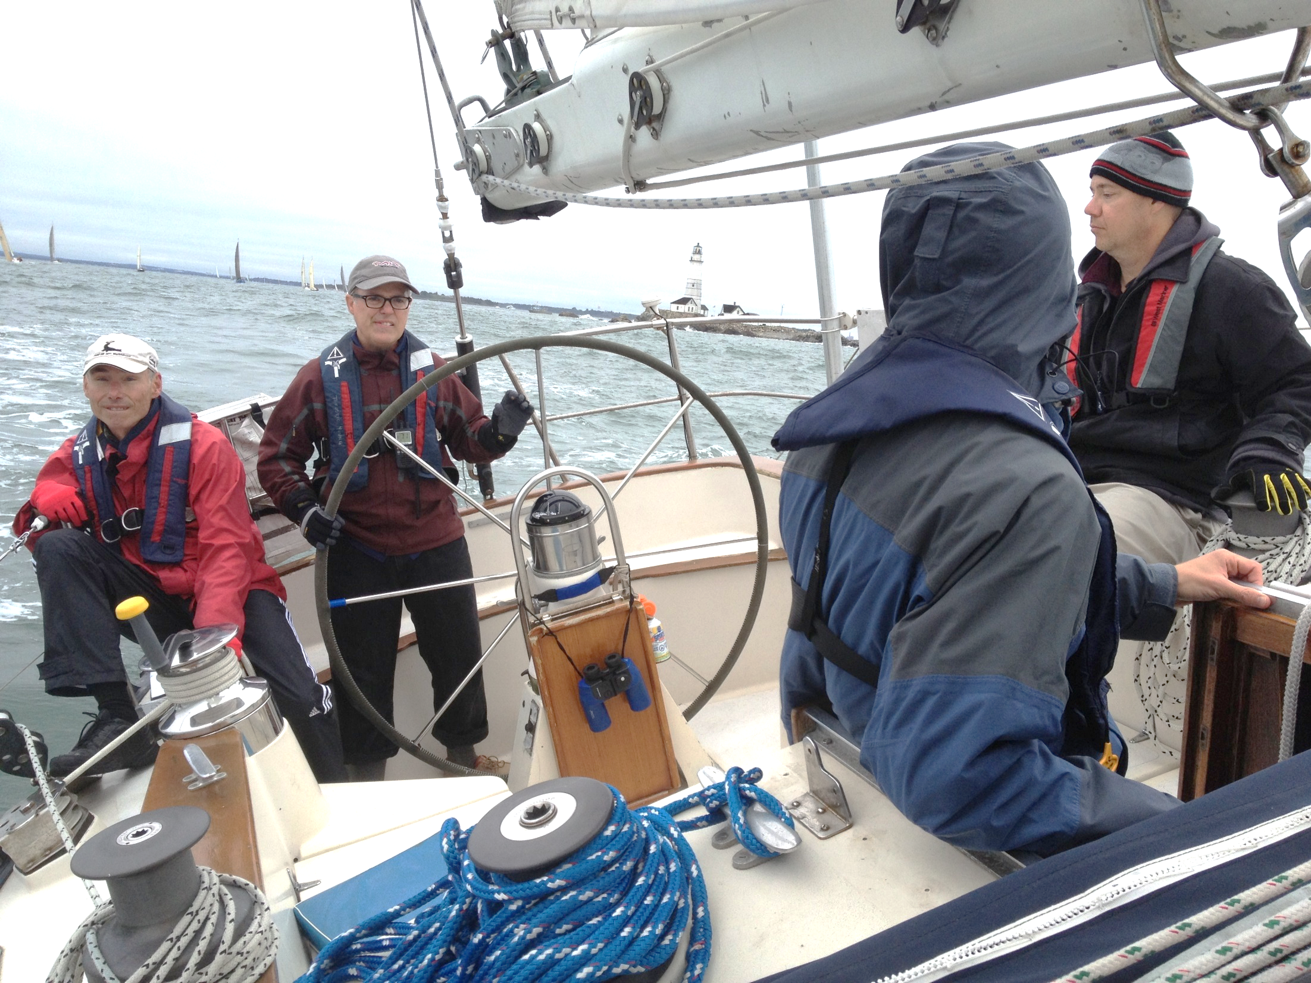

Slide 12
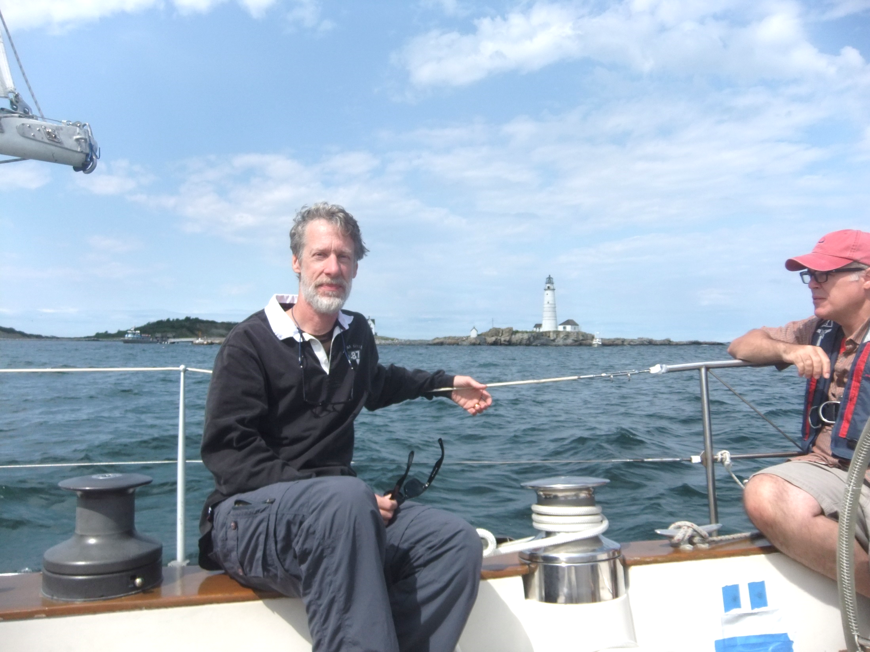

Slide 13
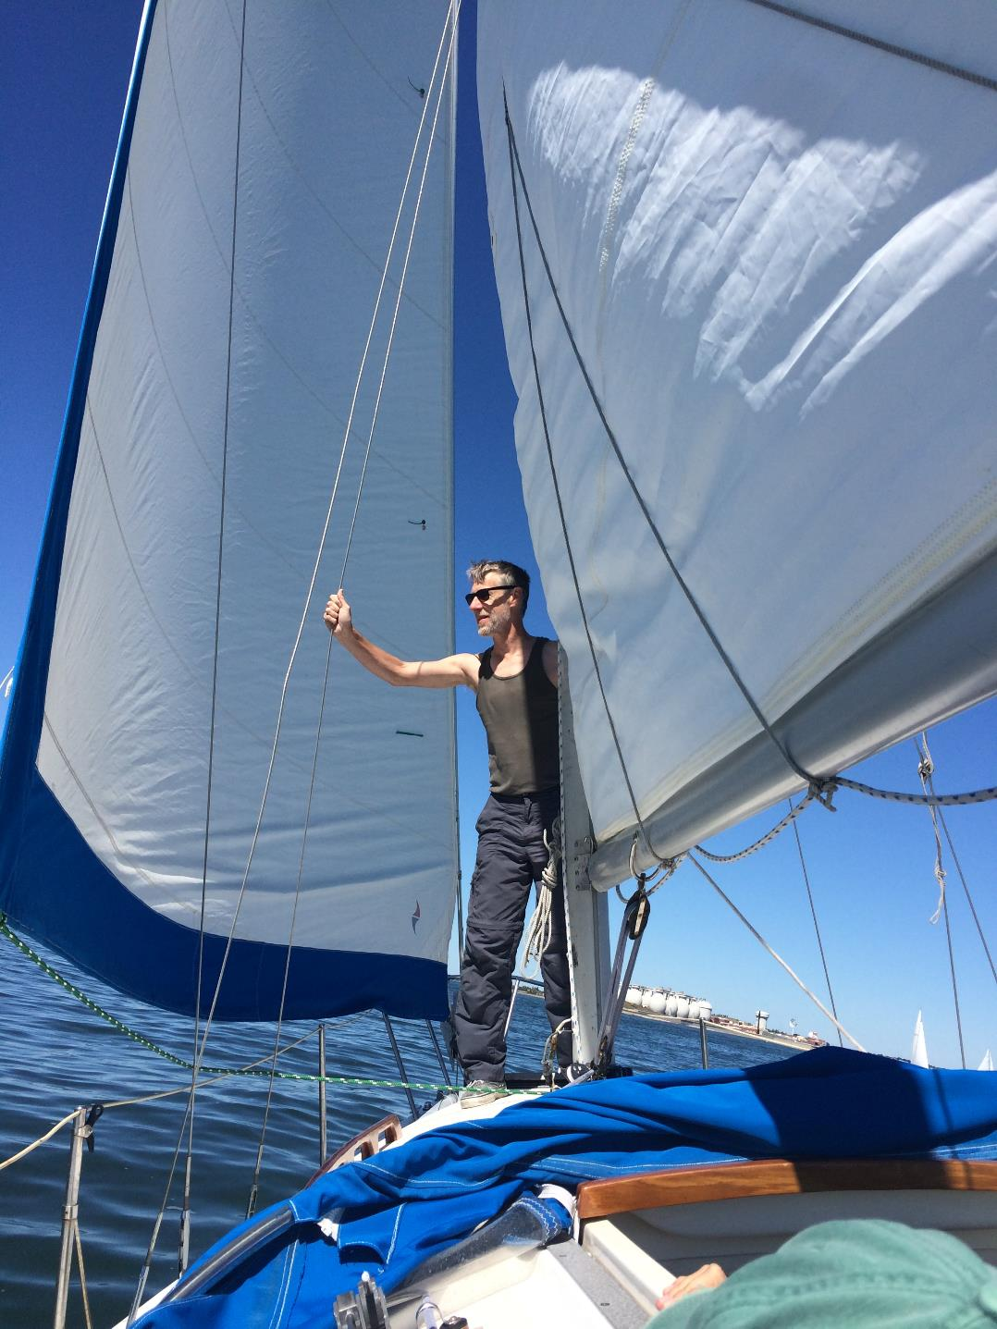

Slide 14
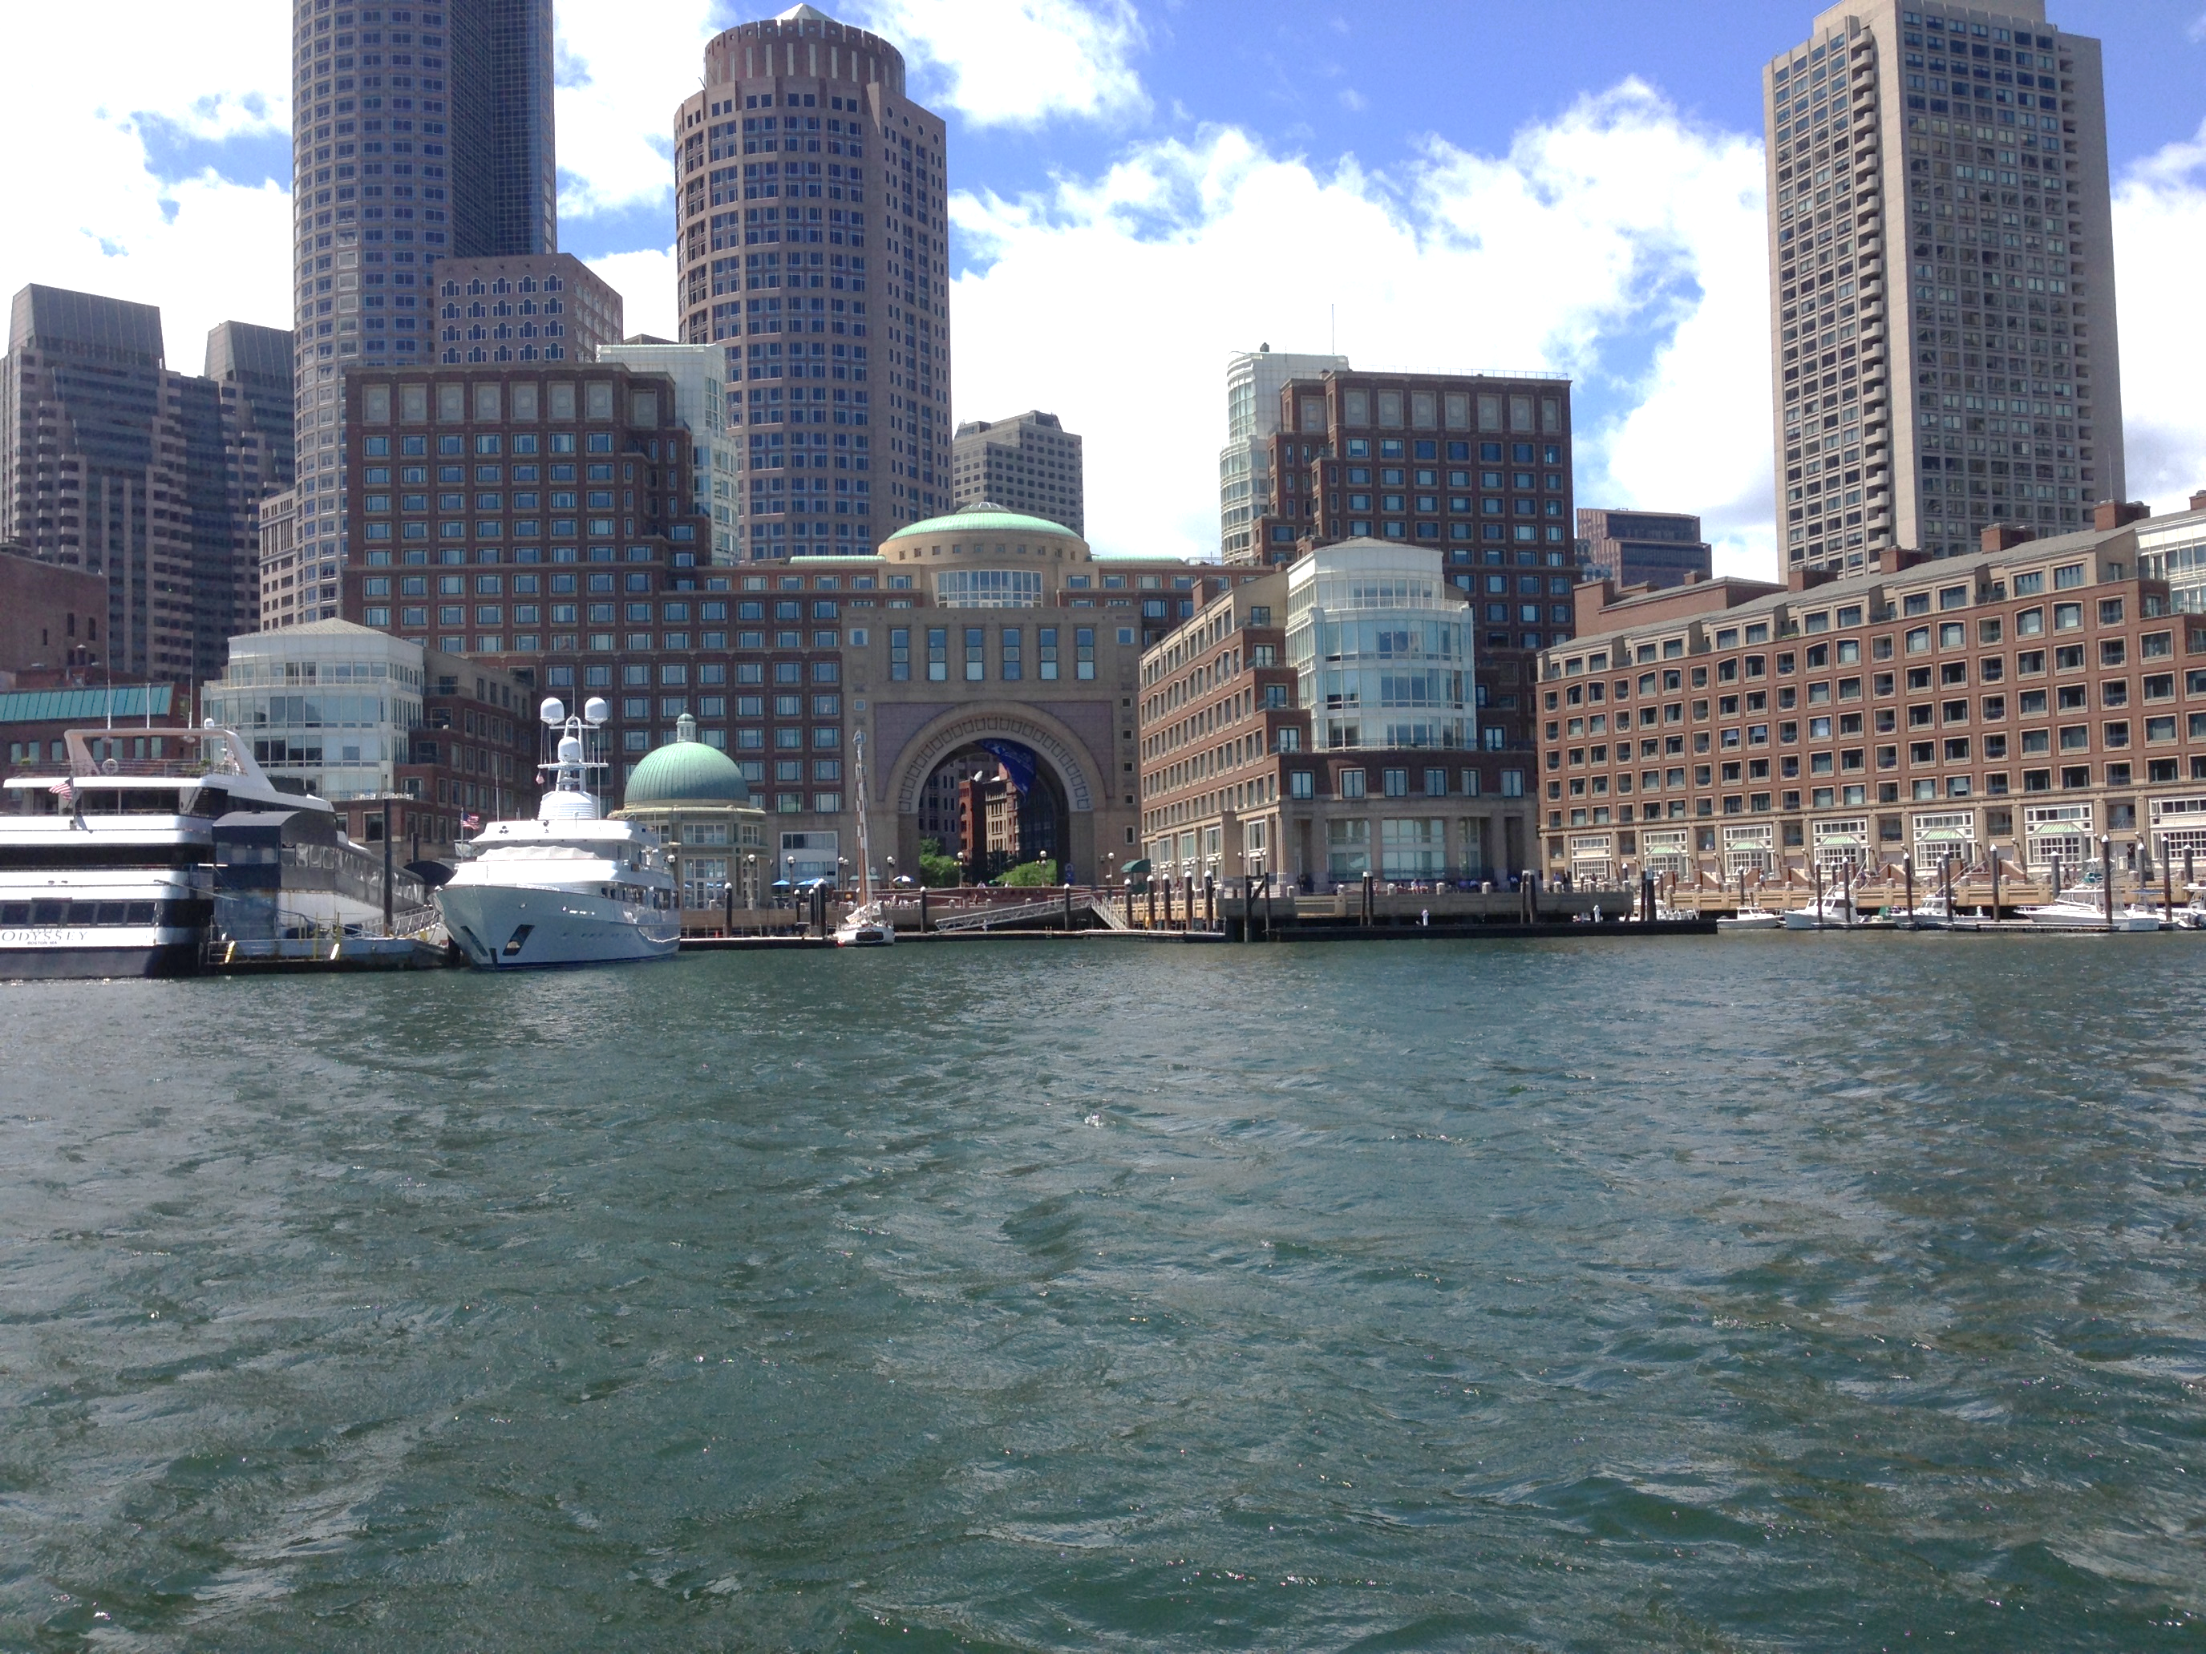

Slide 15
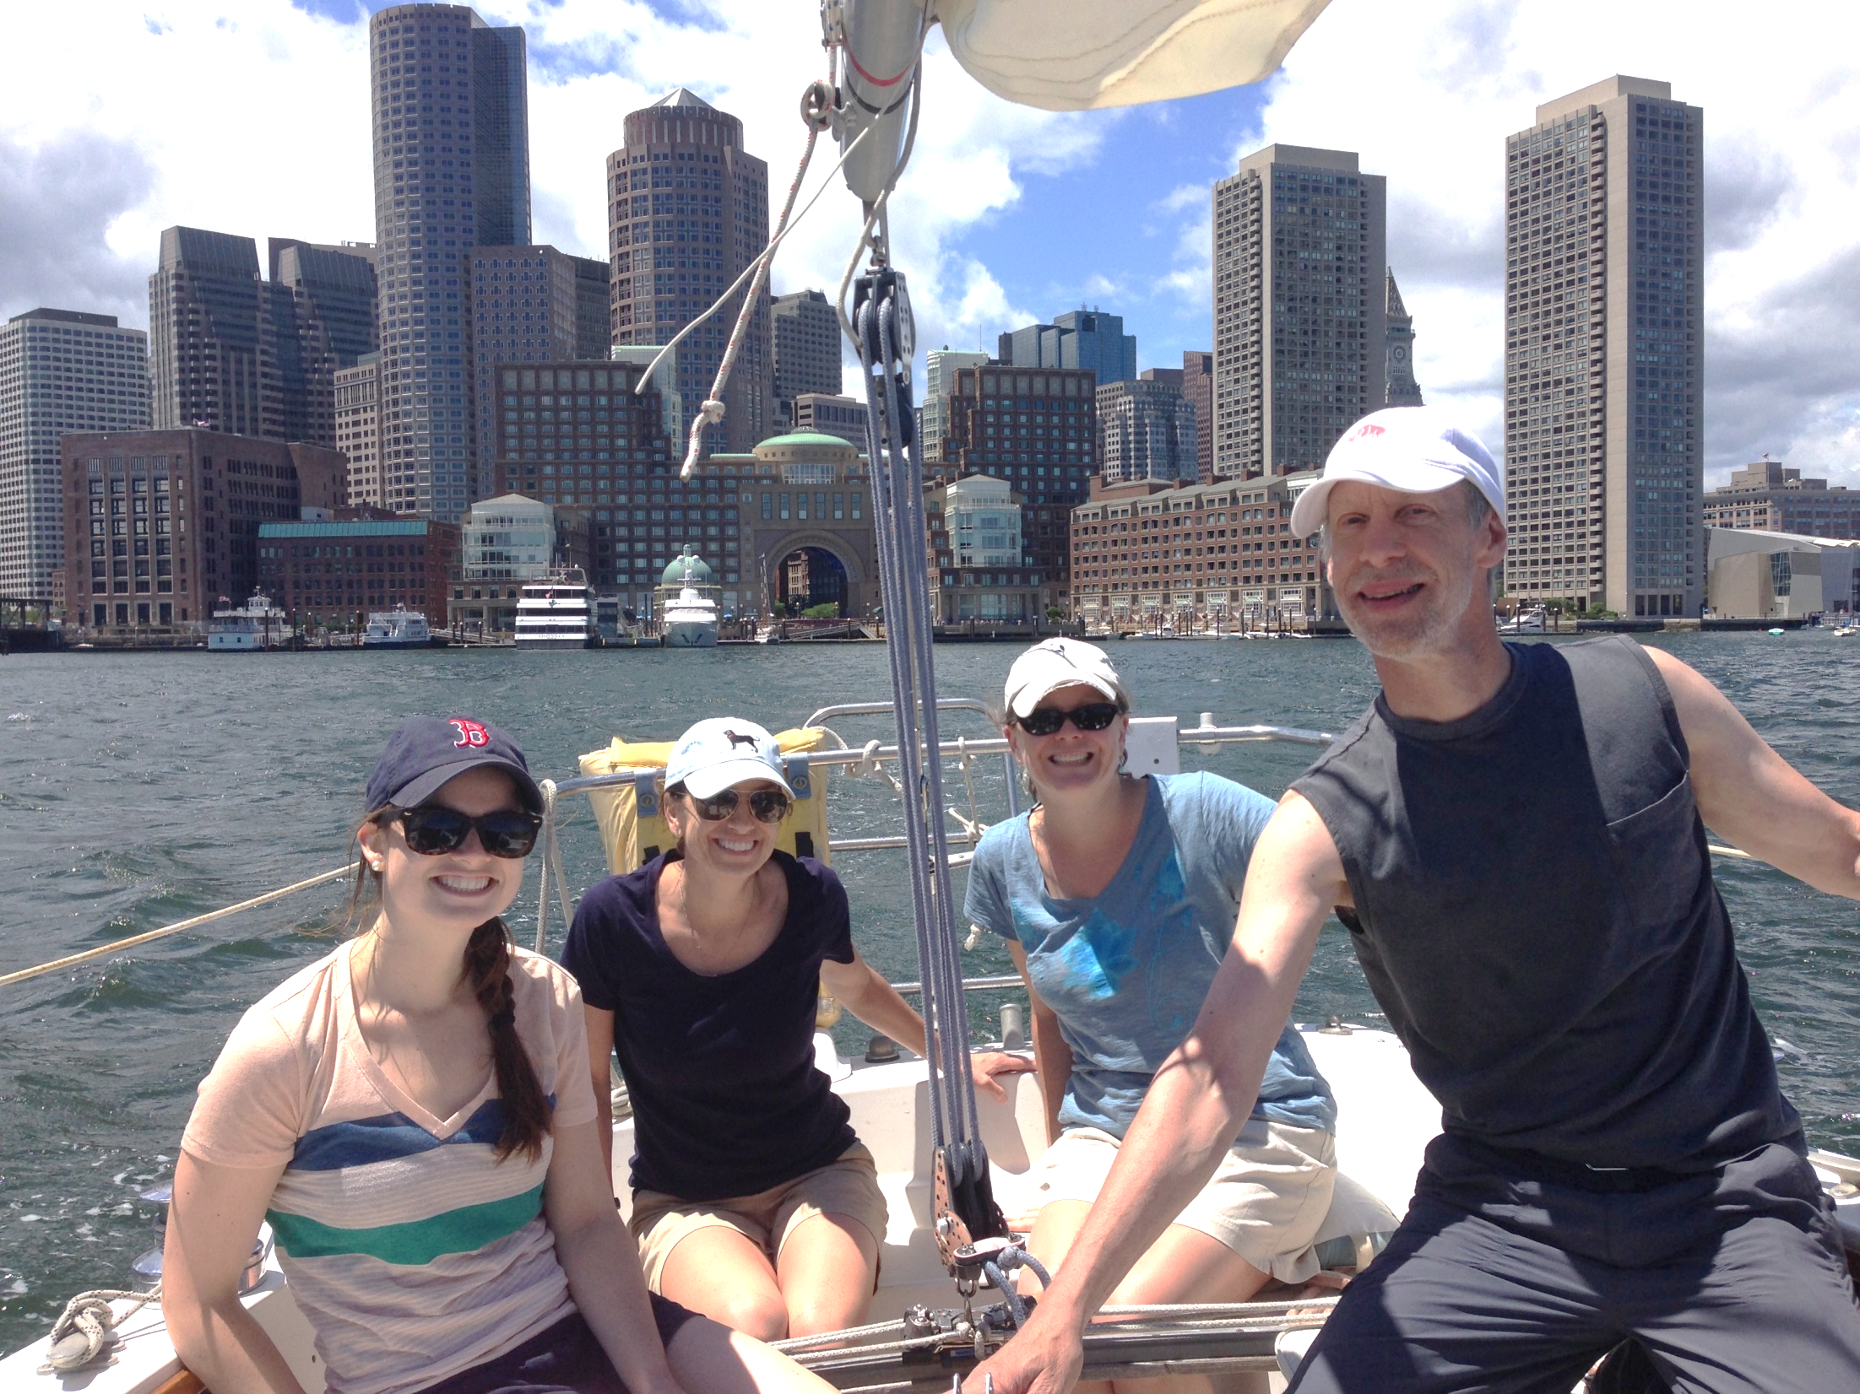

Slide 16
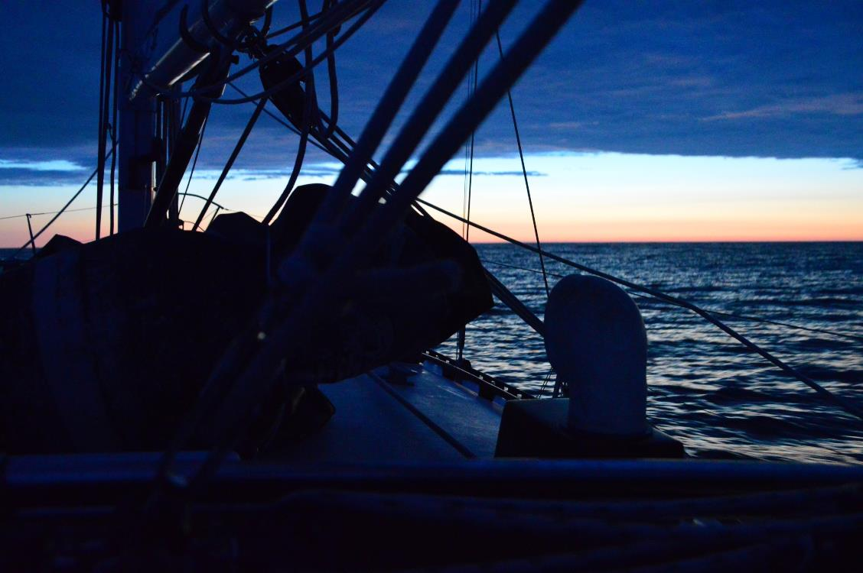

Slide 17
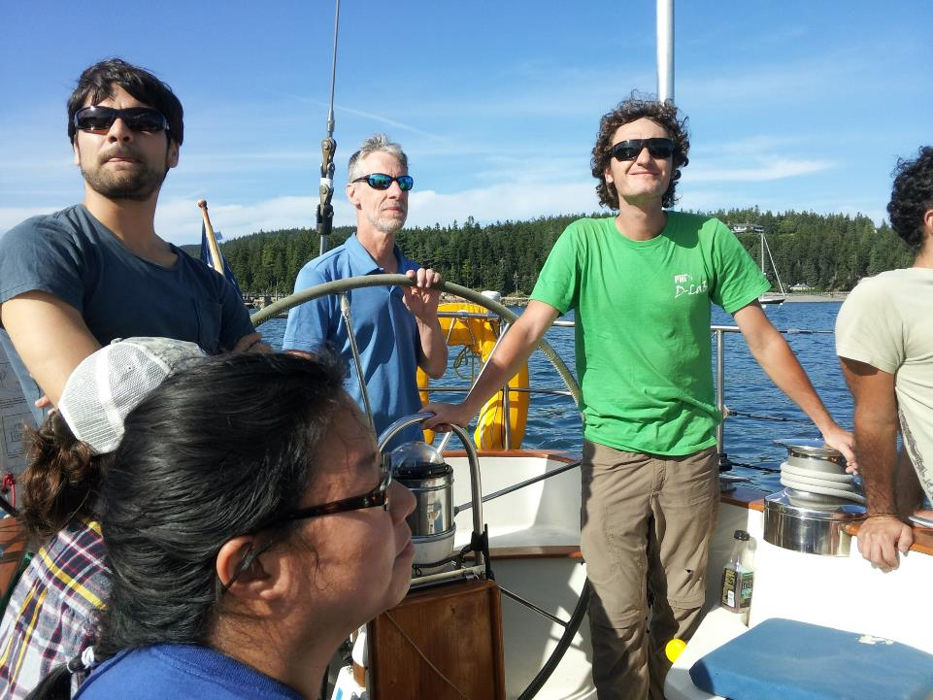

Slide 18
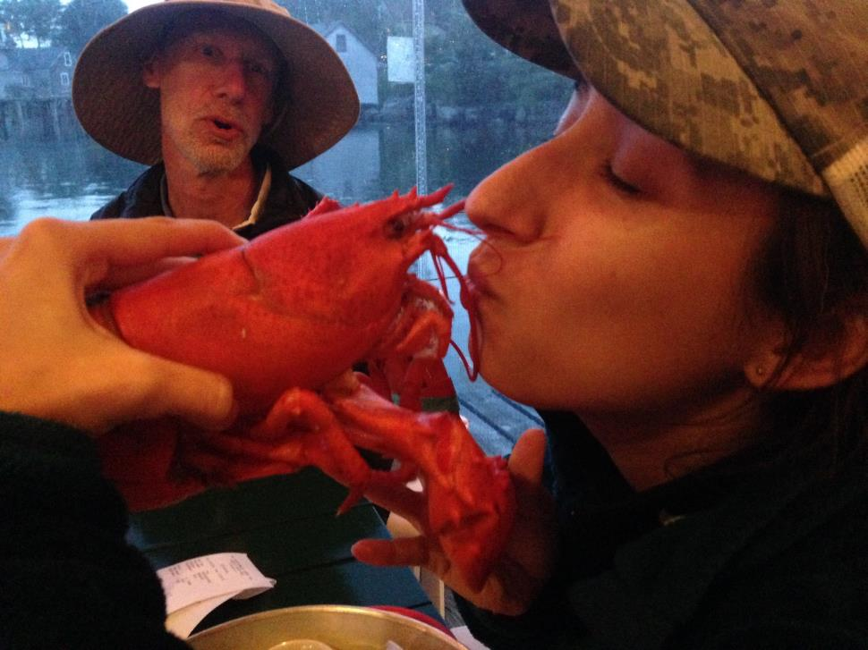

Slide 19
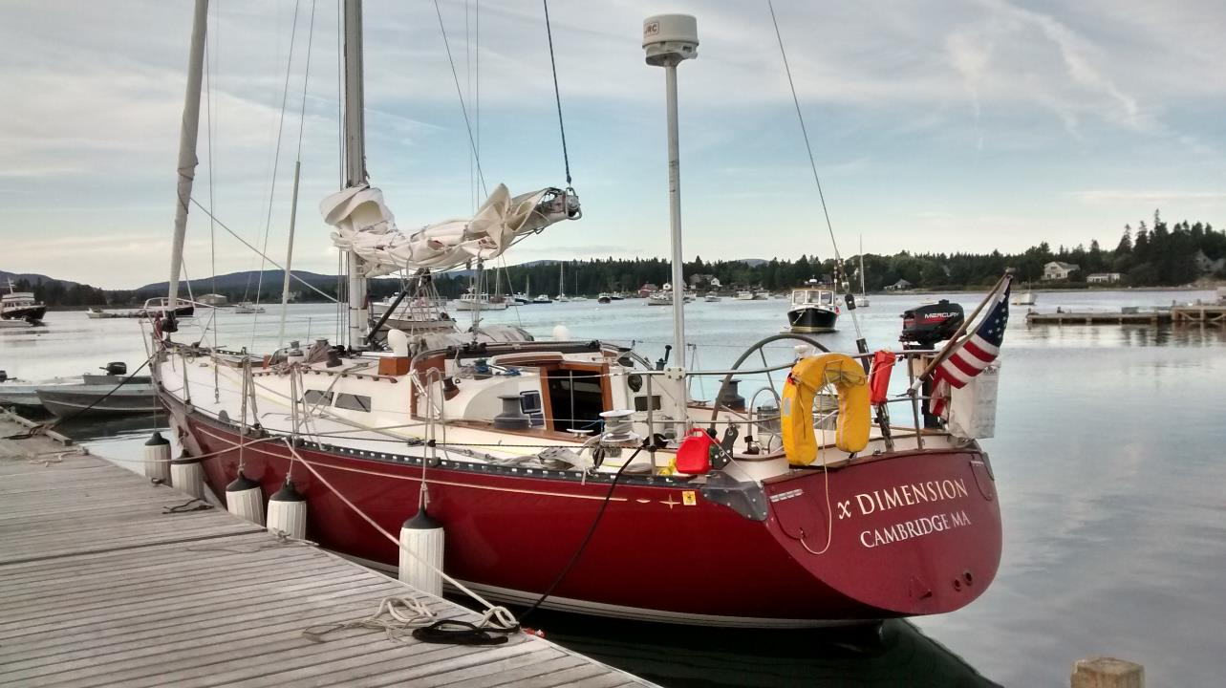

Slide 20
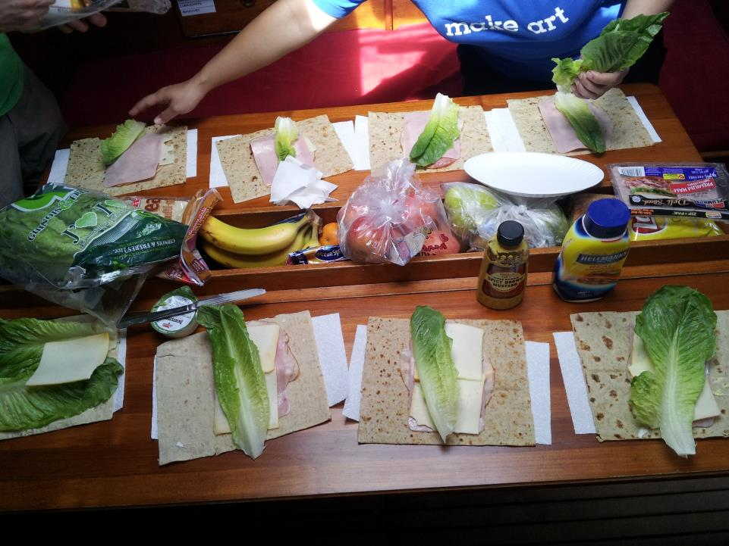

Slide 21
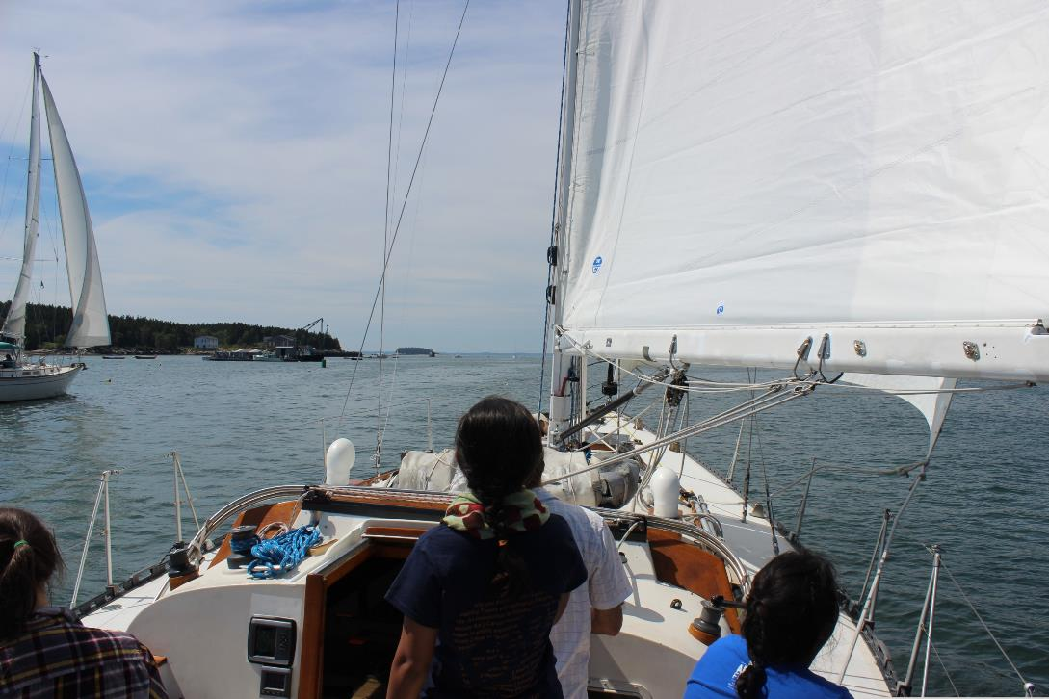

Slide 22
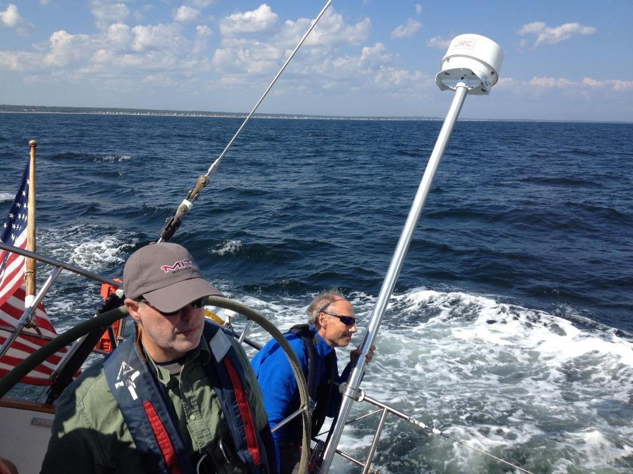

Slide 23
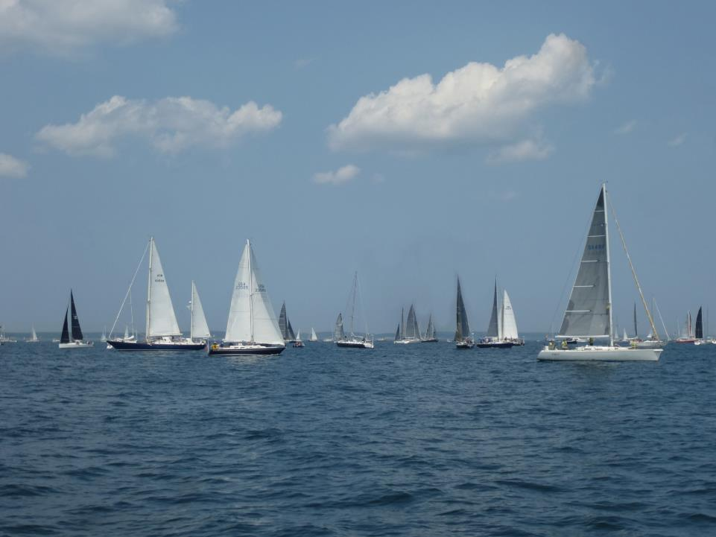

Slide 24
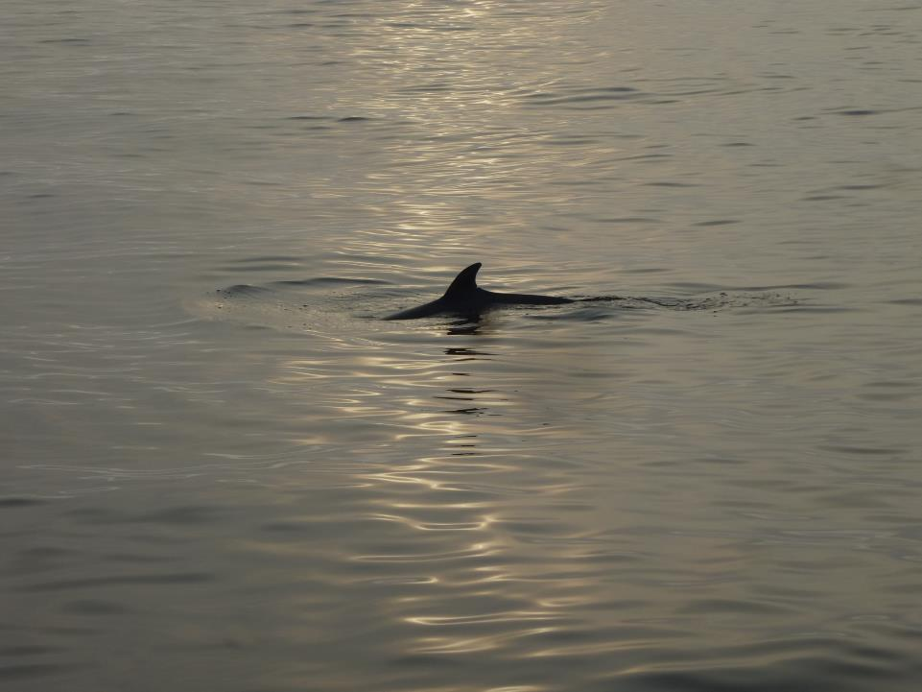

Slide 25
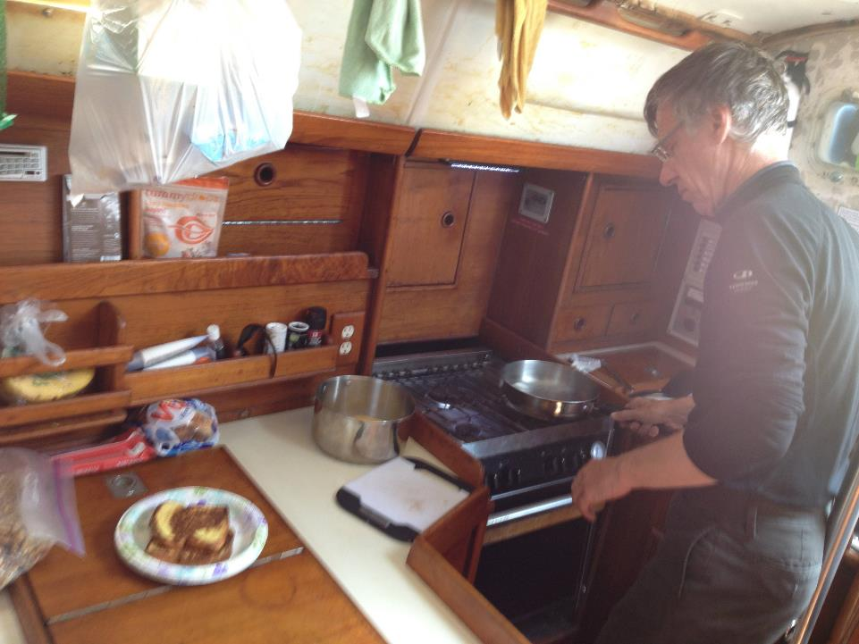

Slide 26
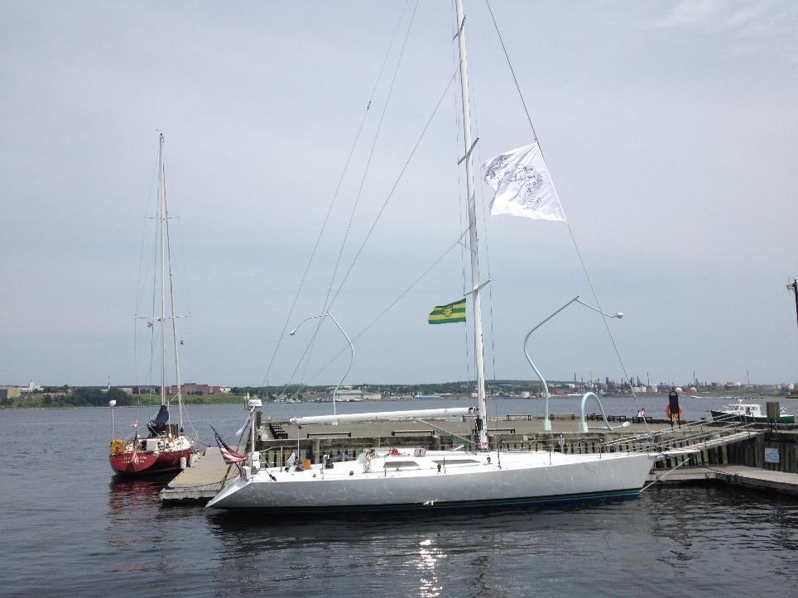

Slide 27
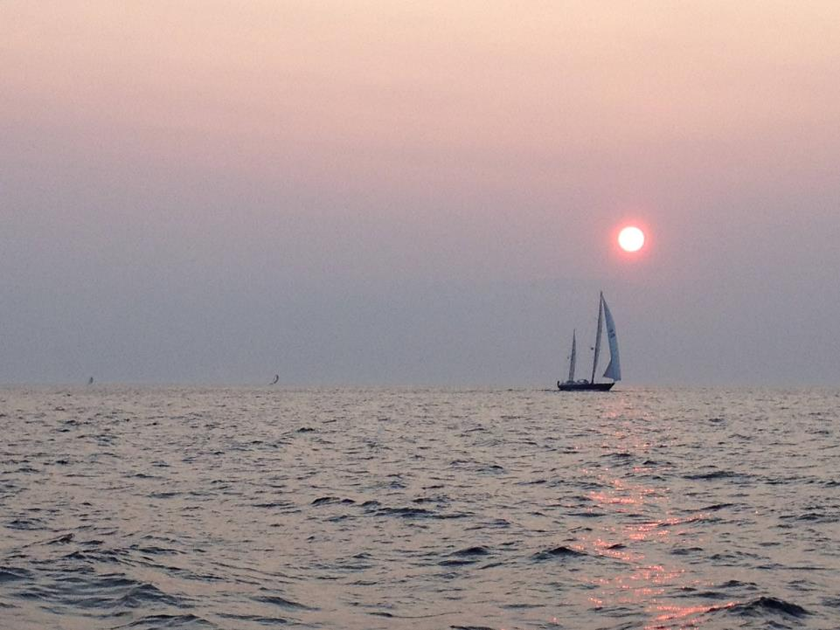

Slide 28
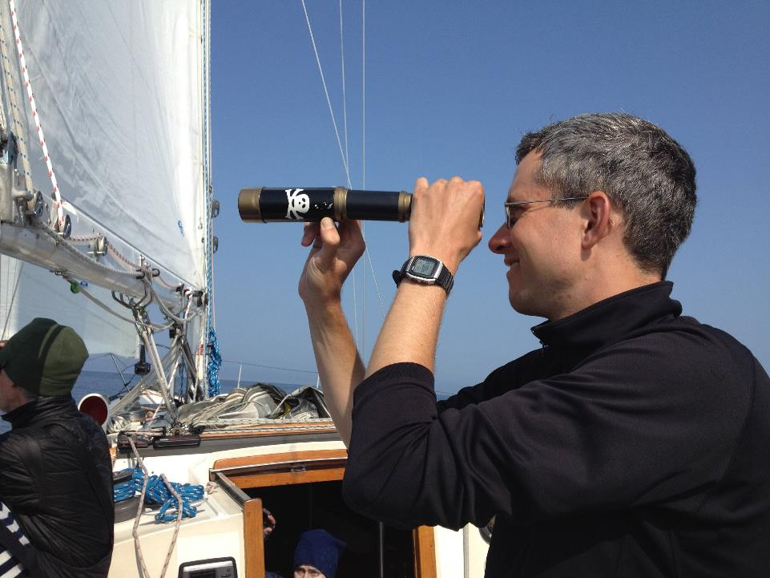

Slide 29
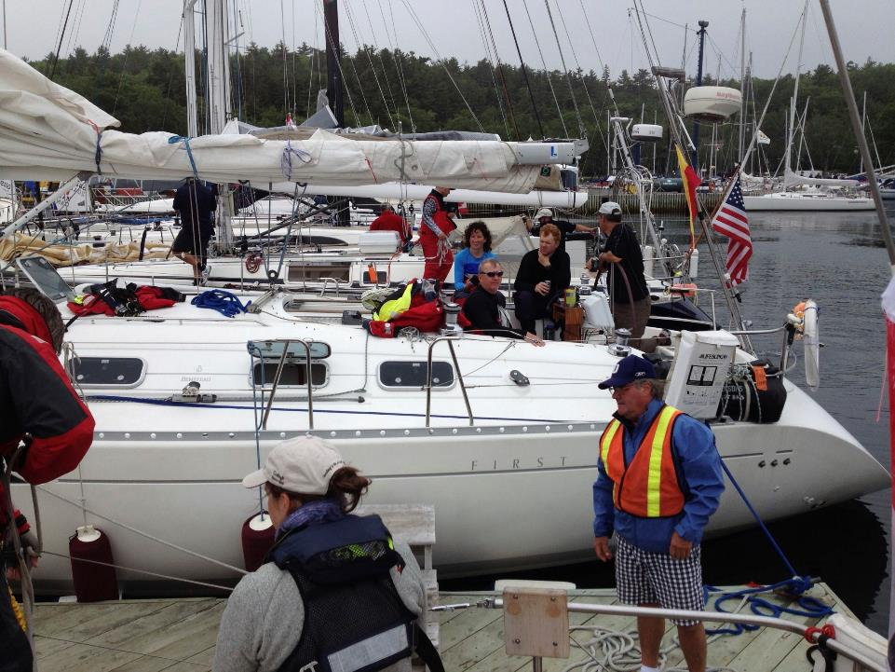

Slide 30
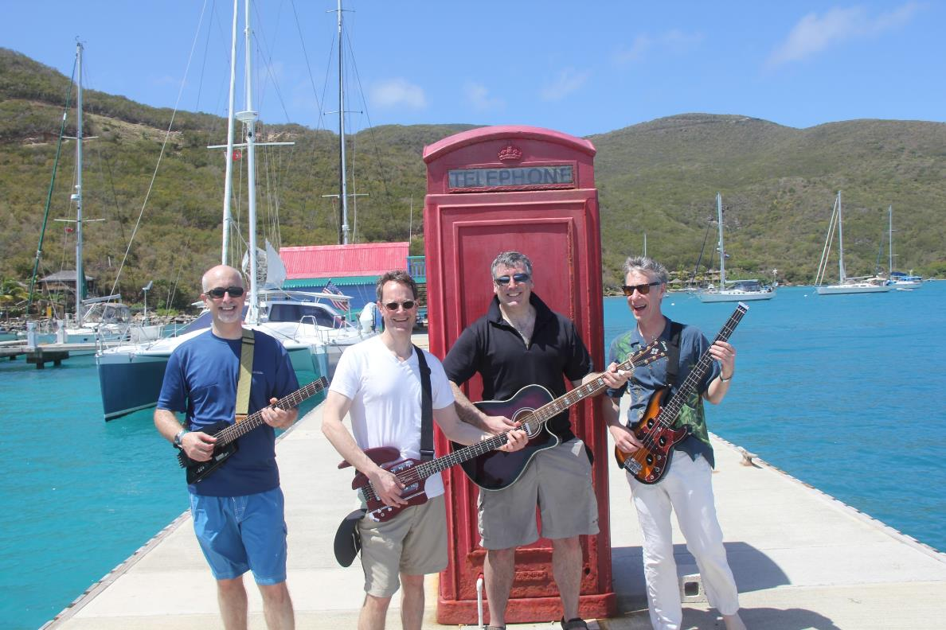

Slide 31
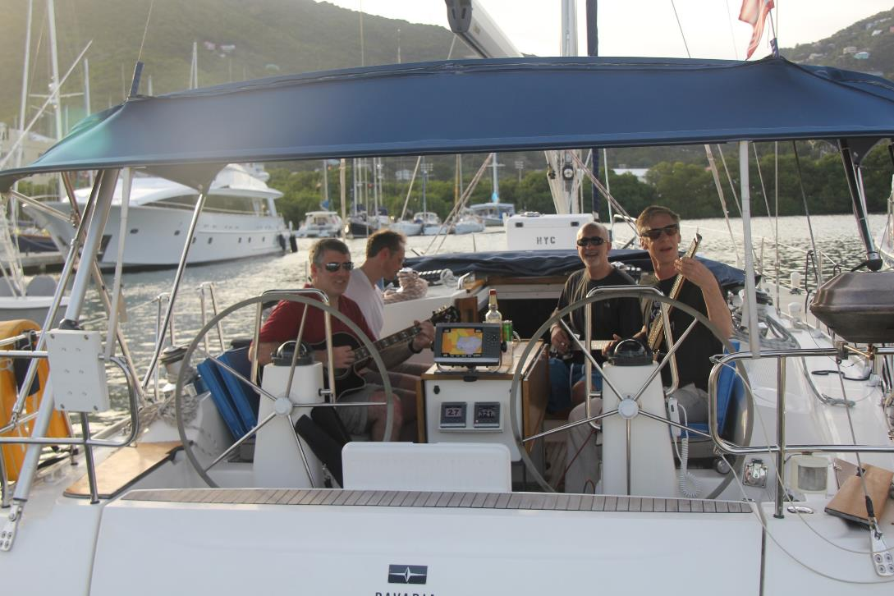

Slide 32
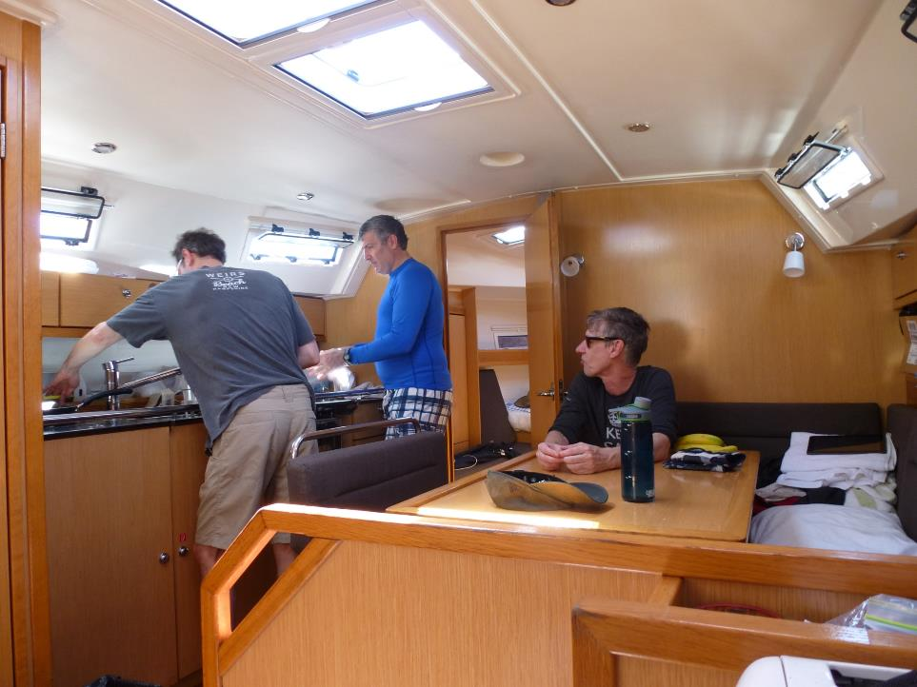

Slide 33
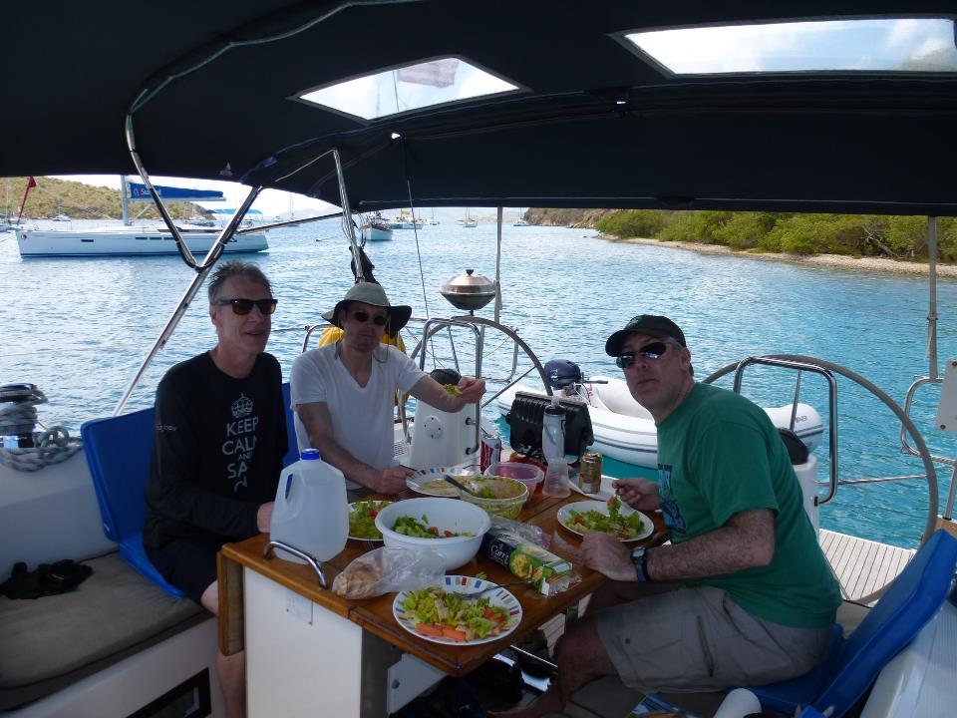

Slide 34
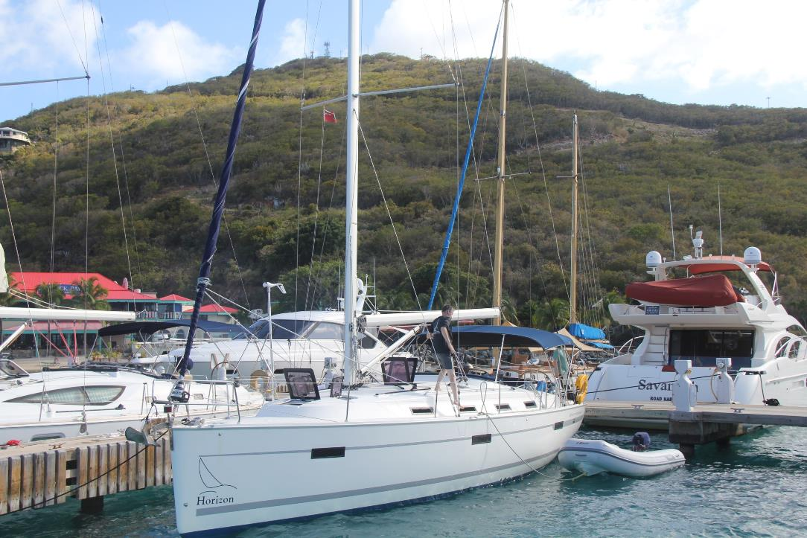

Slide 35
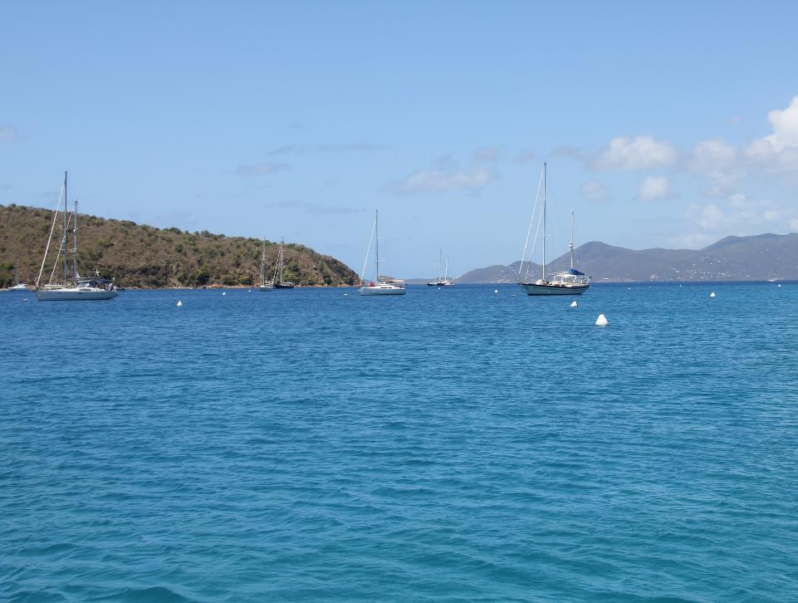

Slide 36
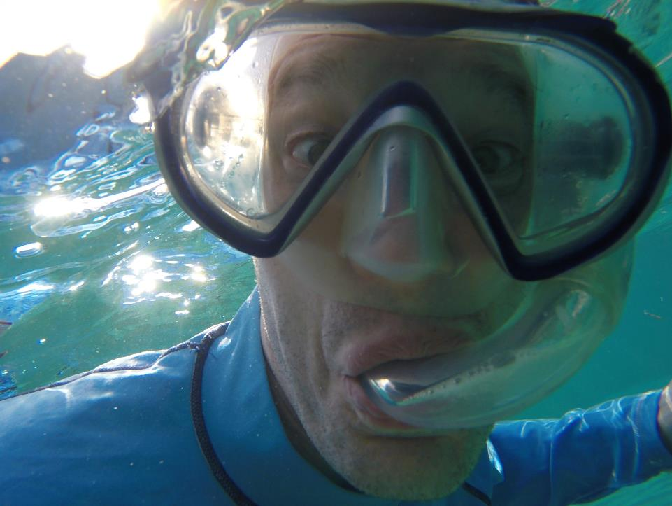

Slide 37
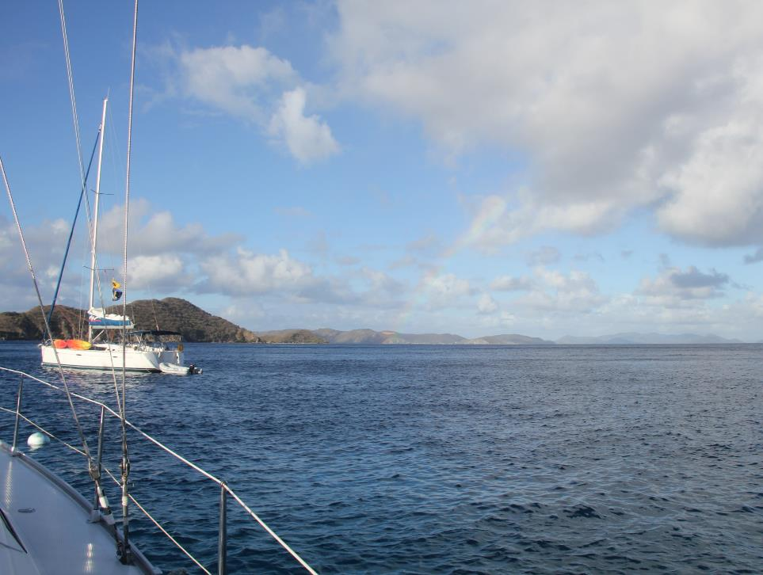

Slide 38
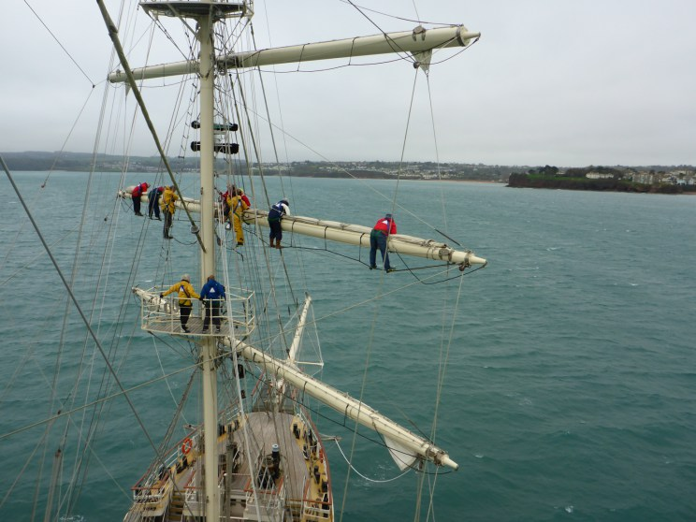

Slide 39
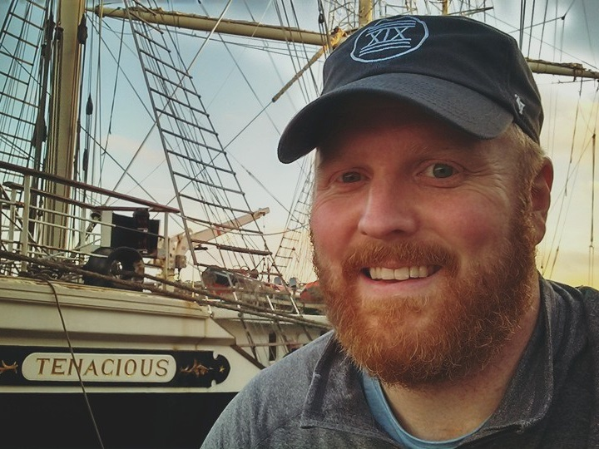

Slide 40
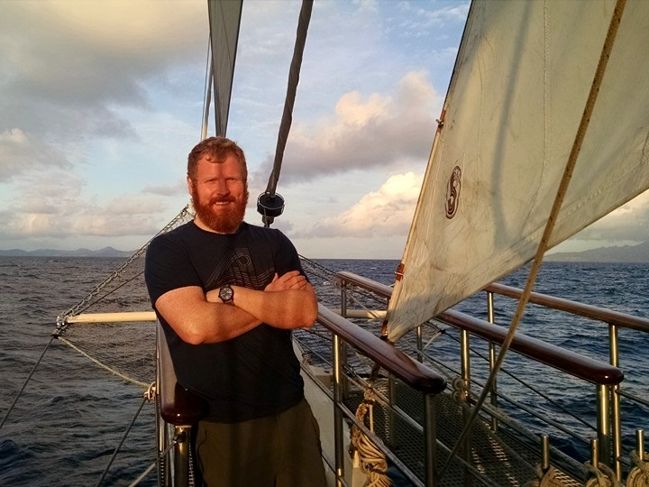

Slide 41
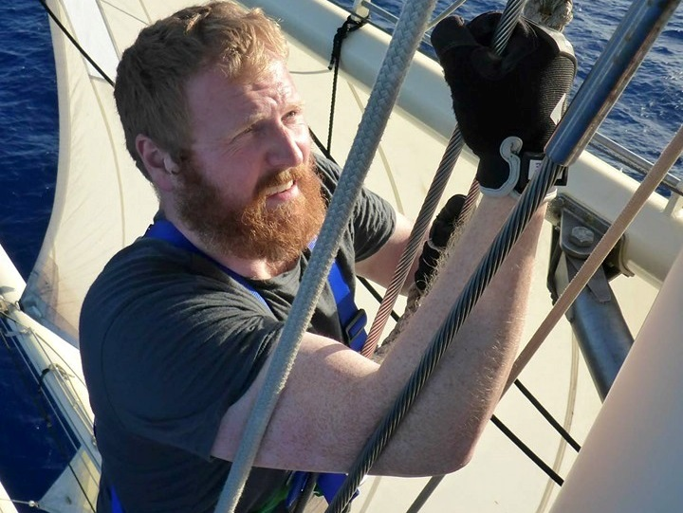

Slide 42
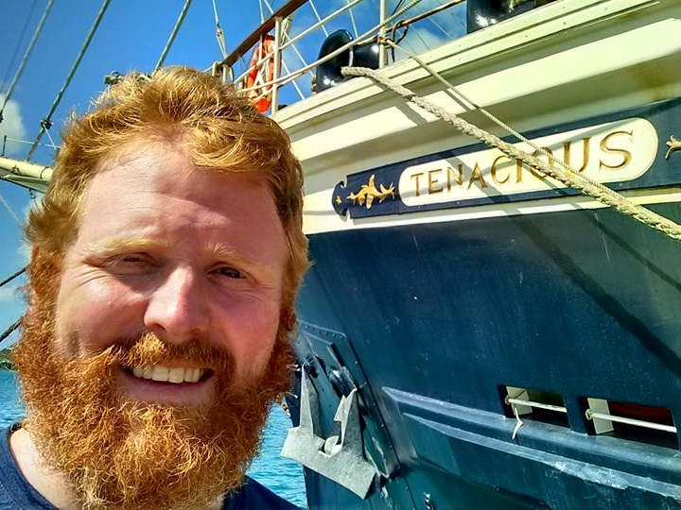

Slide 43
Chart Your Course
Sail with xDimension in 2017
  Sign up for the Bluewater mailing list
Take a certified ASA keelboat training class
Charter a skippered sailing trip
Volunteer to crew on someone else’s boat
Sail across the Atlantic!

Slide 44
Let’s Look At Boats
Monohull vs. Catamaran
Cruiser vs. Racer
Short, Medium, or Long

Slide 45
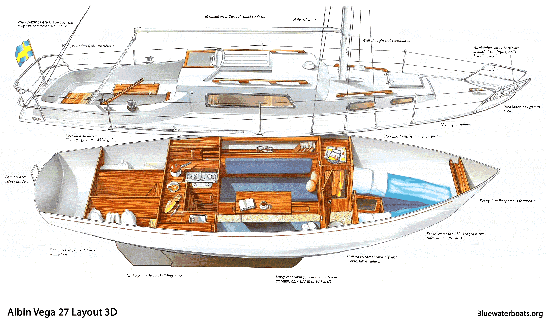
27’ Monohull

Slide 46
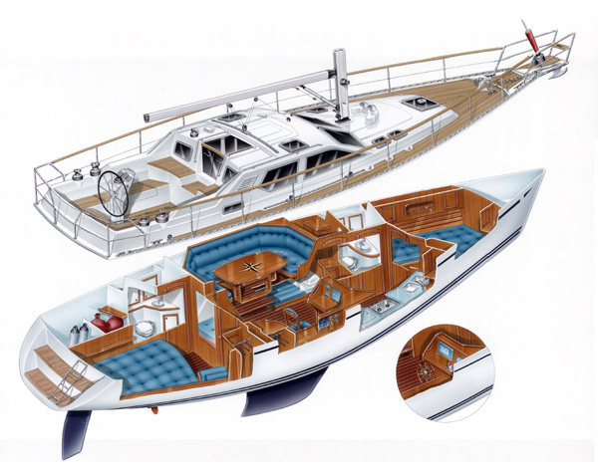
37’ Monohull

Slide 47
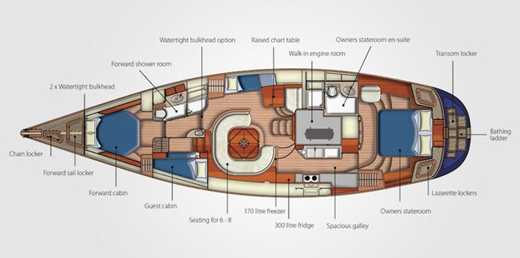
55’ Monohull

Slide 48
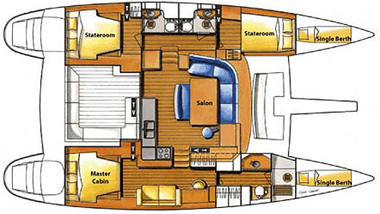
Catamaran

Slide 49
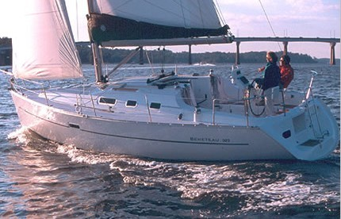
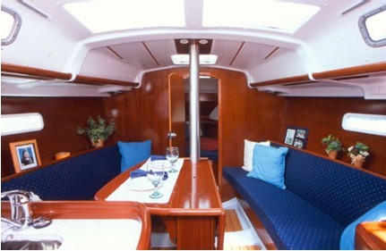
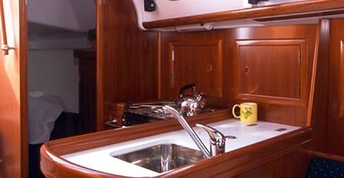
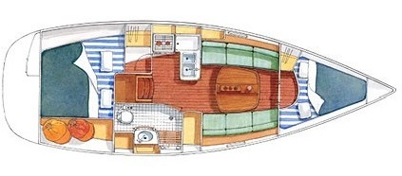
Oceanis 31

Slide 50
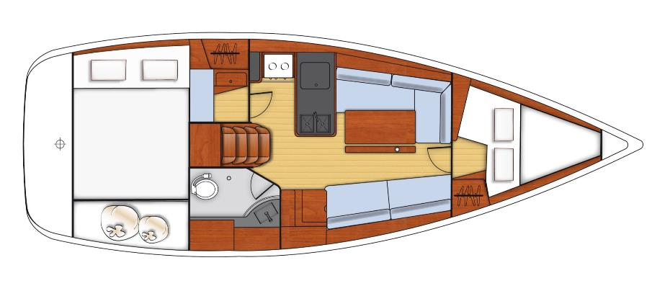
Oceanis 31

Slide 51
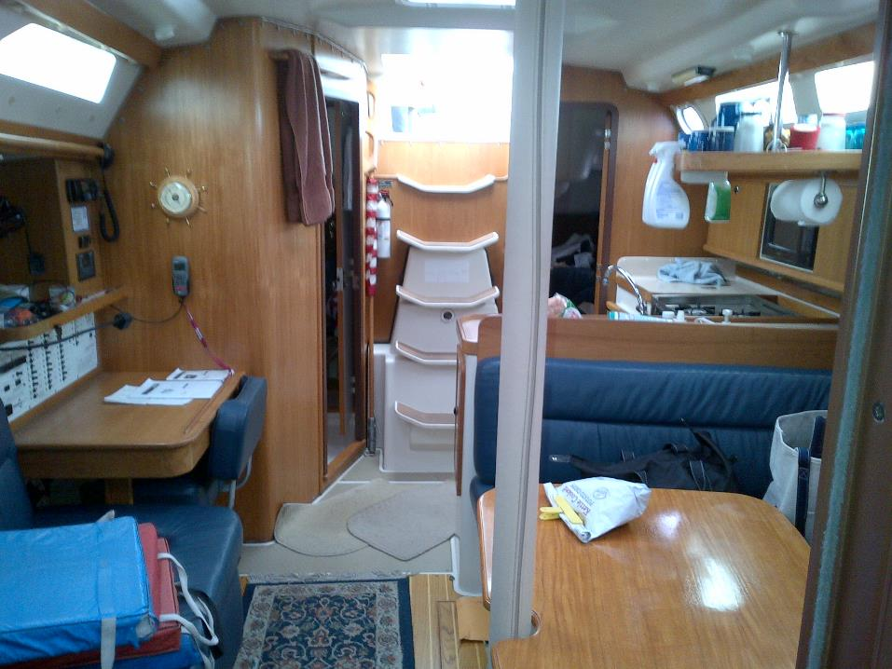

Slide 52
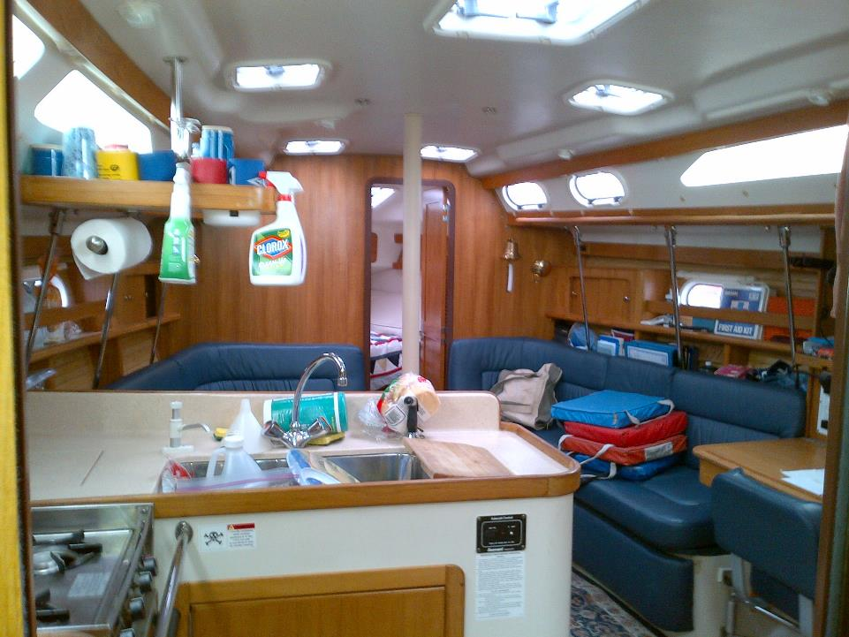

Slide 53
Boat Systems
Engine
Electrical
Navigation lights
Navigation Instruments
Communications
Rigging
Galley
Fresh water
Head
Bilge

Slide 54

Rigging

Slide 55


Galley / Fresh Water

Slide 56

The Head

Slide 57


The Head

Slide 58

The Head

Slide 59

The Bilge

Slide 60

The Bilge

Slide 61



Engine
Outboard
Inboard

Slide 62

Engine

Slide 63


Electrical

Slide 64


Electrical

Slide 65


Navigation Lights

Slide 66



Navigation Instruments
Old School

Slide 67


Navigation Instruments
New Age

Slide 68


Communications
Channel 16: International Distress, Safety, and Calling

Slide 69

Life Aboard

Slide 70
What To Bring?
Clothing (layers!)
Other
It might get cold
  Hat, gloves, base layers
It might get hot
  Sun cover, sun glasses, swim gear
It might rain
  Jacket, overalls, boots
Toiletries
Sunscreen, lip balm
Medication, aspirin, etc.
Camera
Phone and car charger
Down time entertainment
  Books and games

Slide 71





Sea Sickness

Slide 72
Do Your Job
Skipper (not you)
Helm
Jib Sheet(s)
Main Sheet / Traveler
Navigation
Galley Cook
Standing Watch

Slide 73


Two Knots To Know
Bowline
Cleat Hitch

Slide 74
Basic Safety
Walking around the boat
Skipper’s safety instruction
PFD (aka life vest)
  Clipping into a jackline
Crew overboard procedure
  Shout, Point, Throw
Calling for help
  Ch 16: Mayday, mayday, mayday
  Flares, horn, smoke, yell

Slide 75

What Next?
Keep coming to this IAP series
Join the Bluewater mailing list
Consider joining us in Maine this summer
Find a friend with a boat.

Slide 76

Fin

