Slide 1
Weather
Eric Brown
Scott Dynes
MIT Bluewater Skippers

Slide 2
Aim of this session
Over the next two hours we hope to give you an overview of weather from a primarily practical standpoint. After this session you should:
Understand what the near-term weather will be from looking at the clouds
Know where to look for detailed weather forecasts, both on land and on the boat
Know the range of applications that will integrate weather predictions for use on a boat
Of necessity we will not go into any topic in detail; there are plenty of sites on the web for further exploration.

Slide 3
Agenda
Weather Basics
Where does the weather come from?
Fronts and air masses
Cloud types
Wind, waves, and warnings
Practical forecasting
What can you tell from looking at the skies and barometer? (pictures, stories)
Wave heights (wind and fetches) (there’s a standard chart for this)
Forecasting products
The wide range and uses of forecasting products (NOAA surface and 500 mb, weather radar on your phone, gribs, ???)
What is available ashore, and how to get them (lots of demos here?)
What is available onboard (some digging required?)

Slide 4
The Causes of Weather
Atmospheric pressure
The global wind pattern
Wind and weather
Air masses
Atmospheric pressure
Isobars
Dew point (determines bottom of cloud formations, fog, and rain)

Slide 5
The Causes of Weather
Weather is caused by the interactions of air masses that are not in equilibrium – different pressures, temperatures, and moisture content.
Air masses are vast expanses of air that have similar densities, temperatures and moisture and arise from different geographical regions; they move as part of the prevailing winds.
When two dissimilar air masses meet, their boundary is a ‘front’, which is what gives rise to much of the interesting weather.

Slide 6
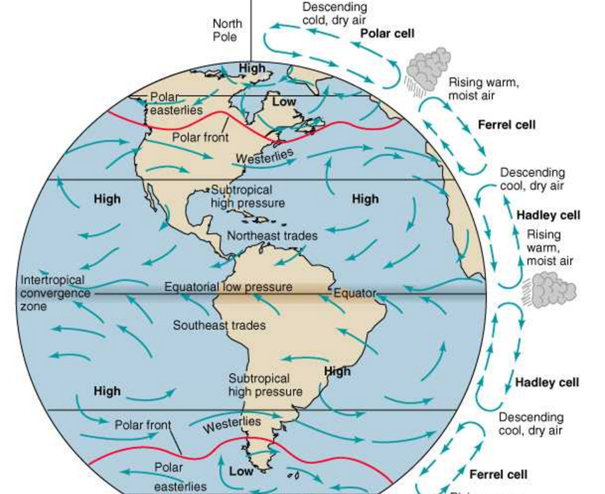
The Causes of Weather
Global Circulation

Slide 7
The Causes of Weather
Origin of Air Masses

Slide 8
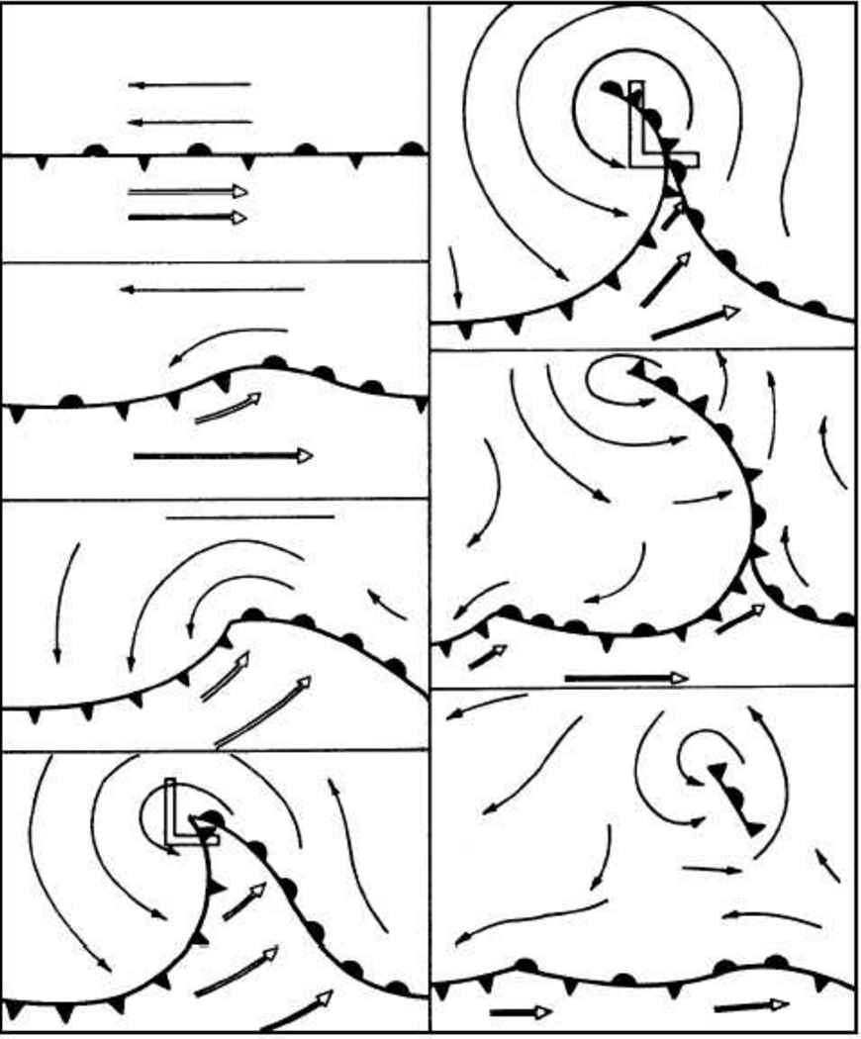
The Causes of Weather
Fronts and Weather Systems

Slide 9
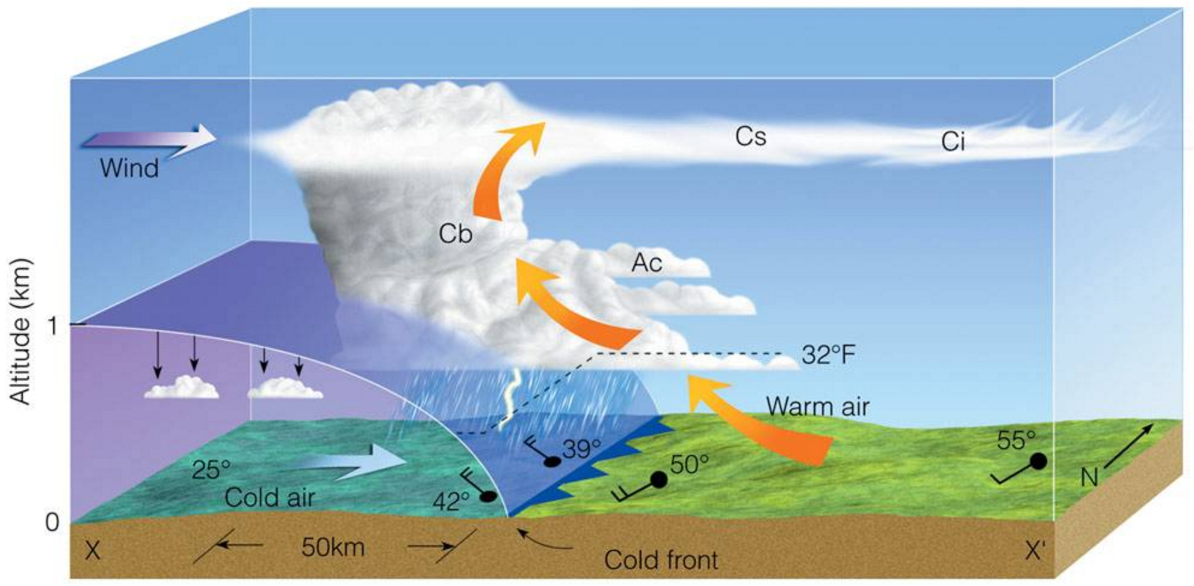
Fronts and Weather Systems
In a Cold Front the Cold Air pushes underneath warm air and causes the air to rise violently and rapidly
– Cold fronts move fast 20- 35 kts
– Generally move E-SE
– Weather deteriorates rapidly
– Approaching clouds seen 50- 150 miles ahead of cold front

Slide 10
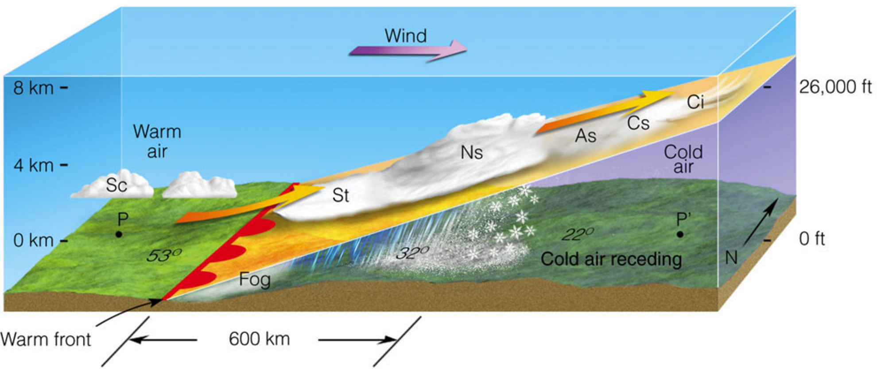
Fronts and Weather Systems
In a Warm Front warm air slides over cold air
Moves slowly 10-15kts
Weather deteriorates gradually
Approaching clouds seen from 1000+ miles
Symbol marking the front is a line with red half circles (warm air is behind the line)

Slide 11
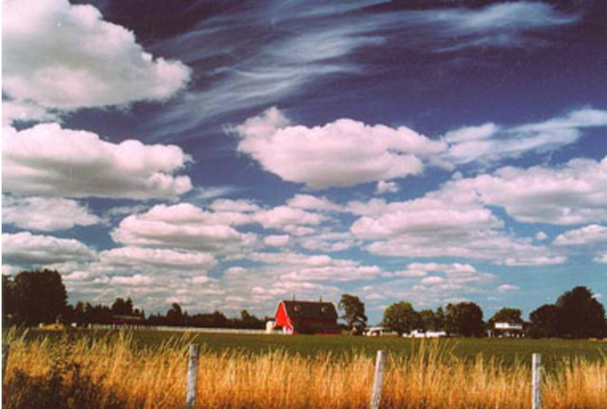
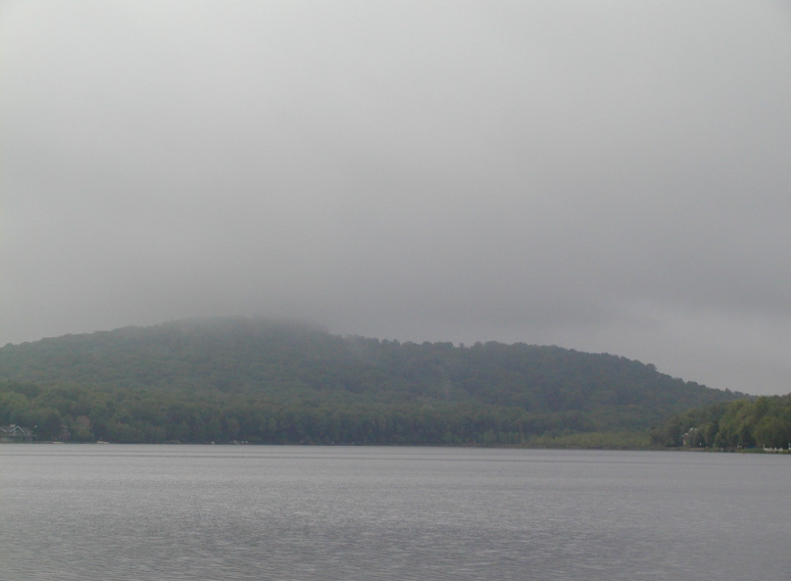
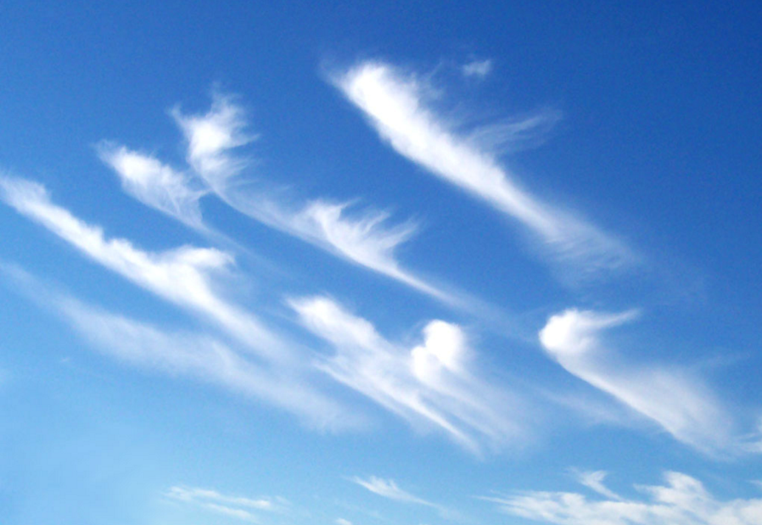
Fronts and Weather Systems
Cloud Types
The basic categorization: shape
Cumulus clouds are puffy
Stratus clouds are flat layers
Cirrus – detached or semi-detached filaments
‘Nimbus’ clouds are associated with precipitation.

Slide 12
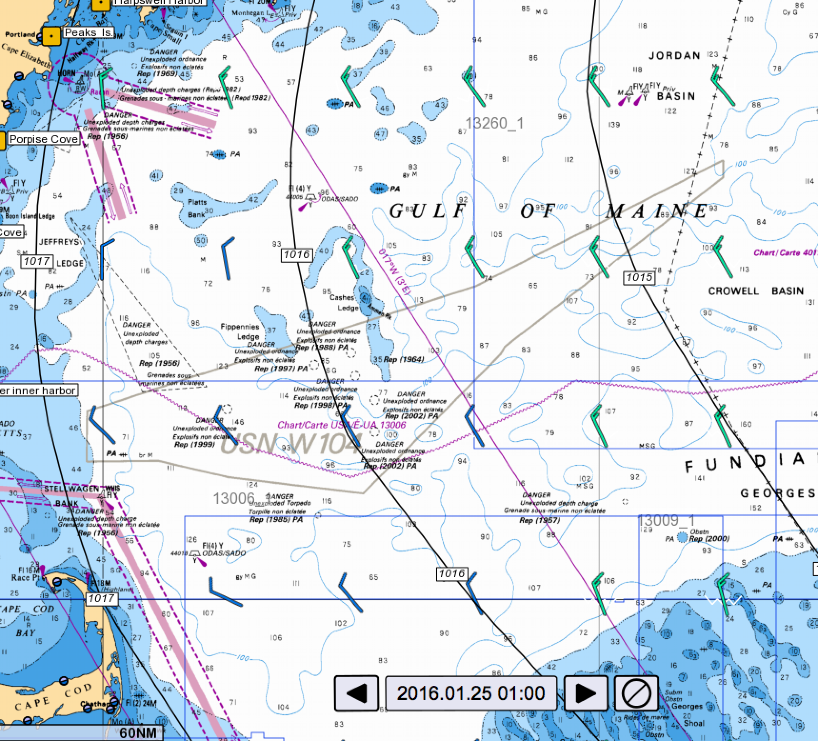
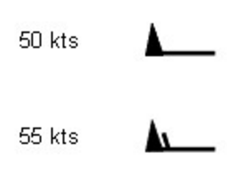
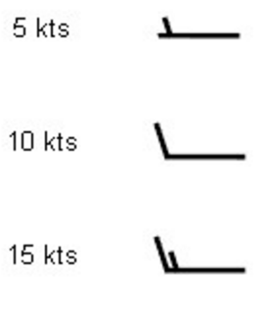
Wind, Waves and Warnings
Wind comes from differences in pressure, and at the surface flows almost along the pressure isobars (due to the Coriolis force).
Direction and speed is represented on charts via a wind barb; the barb ‘points’ in the direction the wind is going.

Slide 13
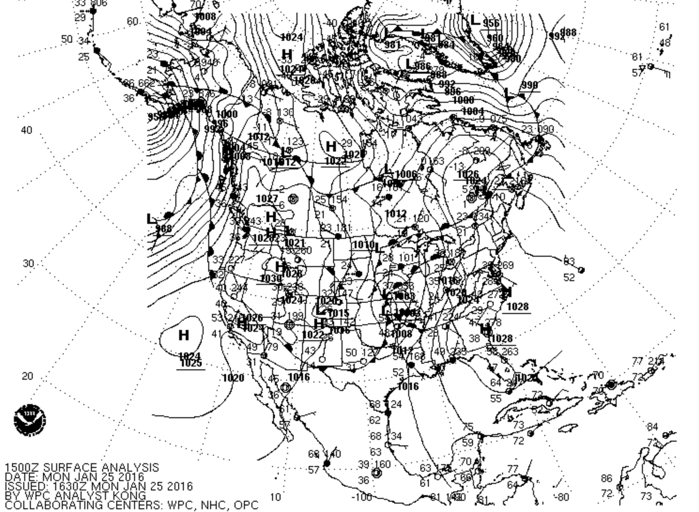
Wind comes from differences in pressure

Slide 14
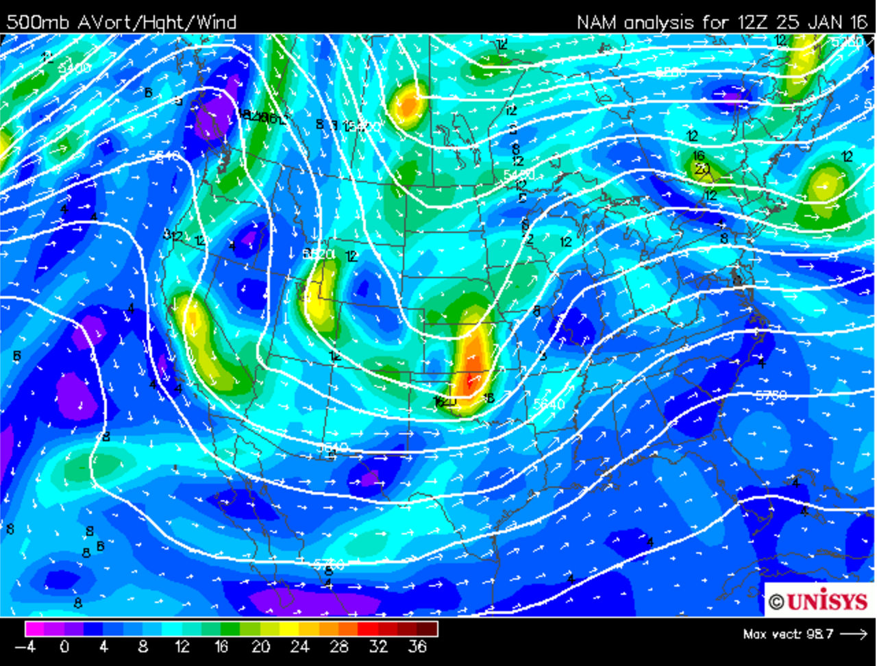
Winds, Waves and Warnings

Slide 15
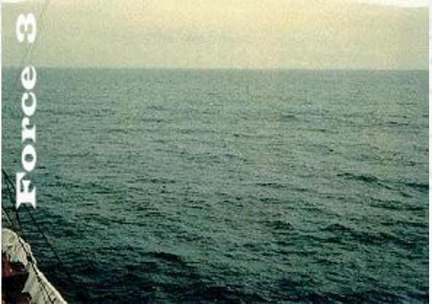
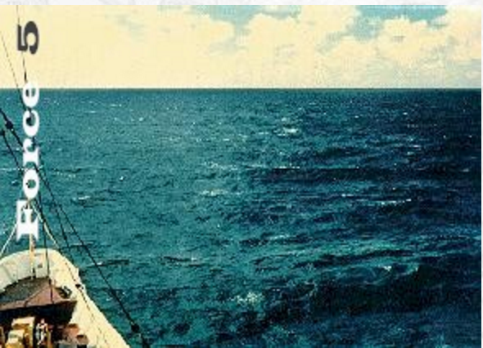
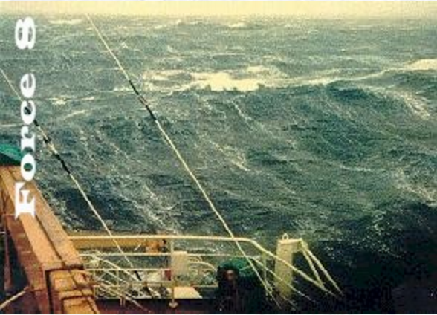
Winds, Waves and Warnings
Beaufort scale – 1-12; ~ 5 kts of wind per number.

Slide 16
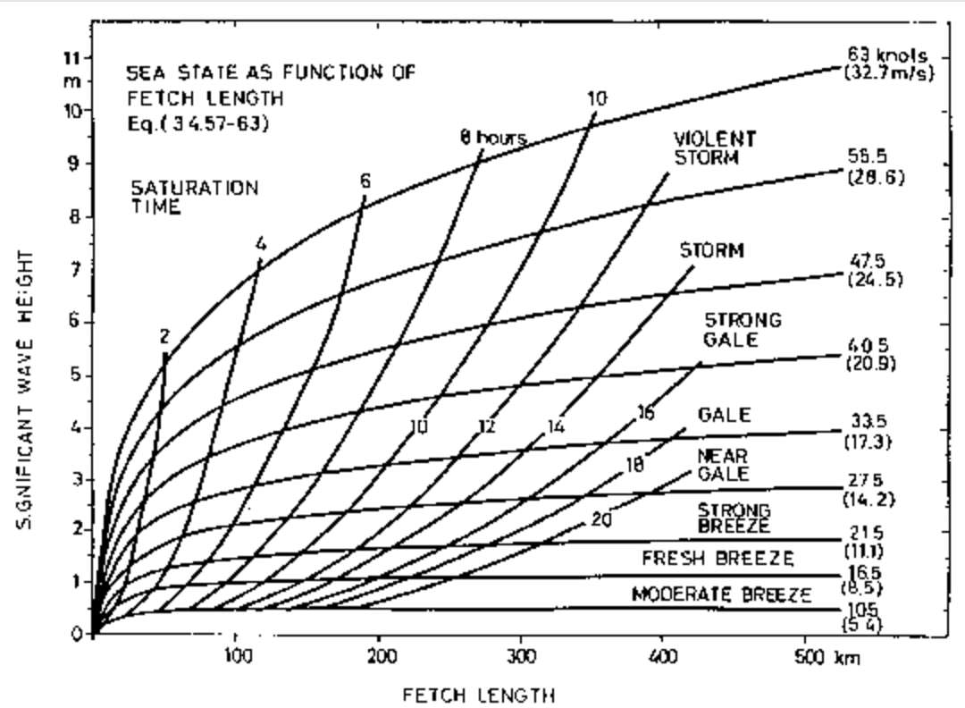
Winds, Waves and Warnings
The greater the wind and the fetch, the higher the wave:

Slide 17
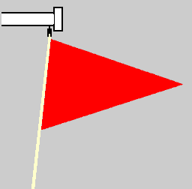
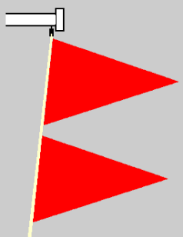
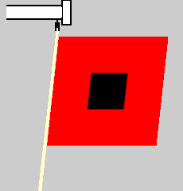
Winds, Waves and Warnings
Warnings
Small craft advisory: forecast winds of 25 kts to 33 kts (no guidance on what a ‘small craft’ is)
Gale warning: forecast winds of 34 kts to 47 kts
Storm warning: forecast winds of 48 kts to 63 kts

Slide 18
Practical forecasting
What can you tell from looking at the skies and barometer?

Slide 19
Reading the Weather
Building cumulus clouds signal wind and storm

Slide 20
Clouds
Stratus: Layered clouds, stable air
Nimbostratus, Stratocumulus, Altostratus, Cirrostratus, Cirrus (progressively higher altitudes)
Cumulus: Puffy clouds, unstable air
Cumulonumbus: Thick, tall, puffy clouds (winds)

Slide 21
Stratus

Slide 22
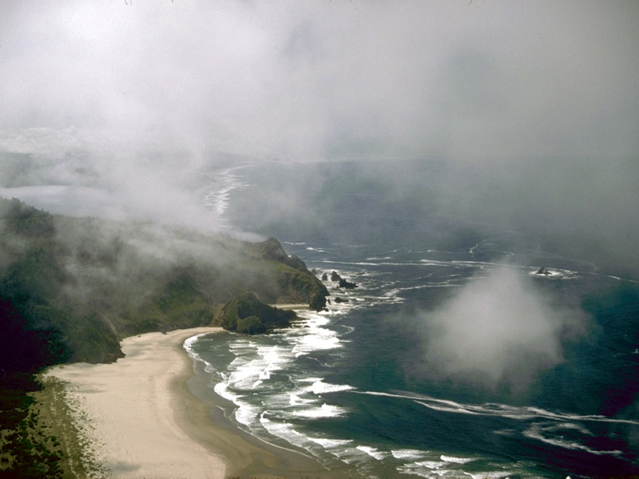
Low-hanging stratus wisps

Slide 23
Classic Altocumulus

Slide 24
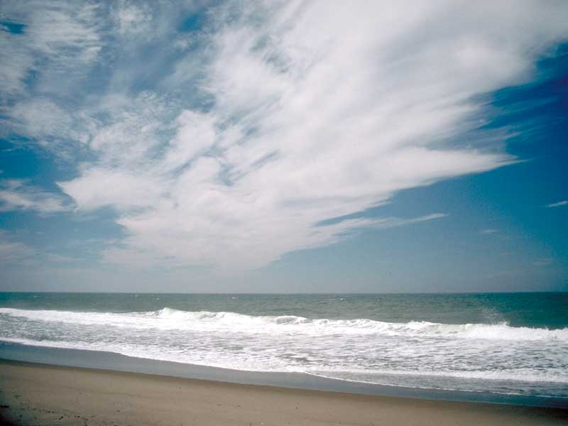
Jet Stream Cirrus

Slide 25
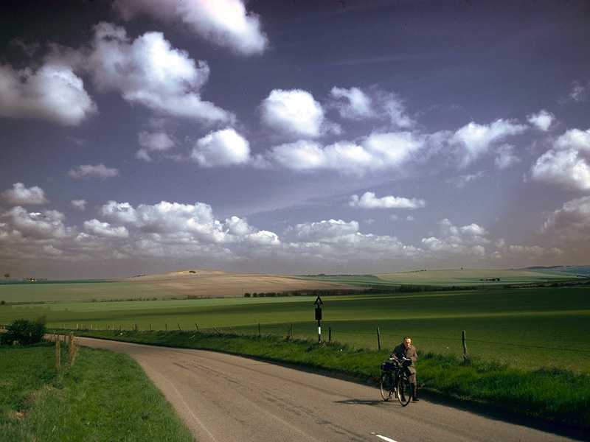
Cumulus of Fair Weather

Slide 26
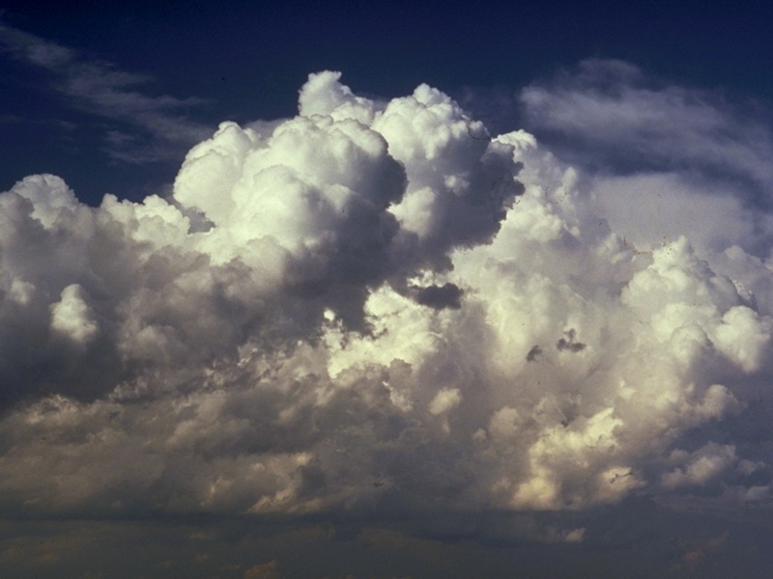
Cumulus Congestus

Slide 27
Reading the Weather
Building cumulus clouds signal wind and storm
Falling barometer
Millibars (mb or mbars) typically 1013.25 mbar
Falling 4 mb in 3 hours, expect winds 20+ knts
Falling 6 mb in 3 hours, expect gale-force winds!

Slide 28
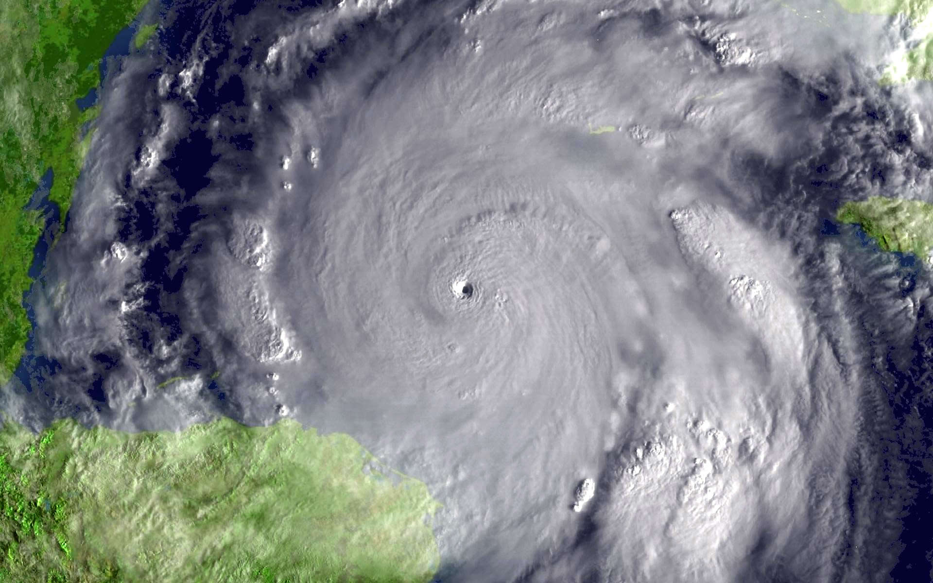
Falling barometer = a Low is coming
Hurricane Wilma (2005)
882 mbar at center!

Slide 29
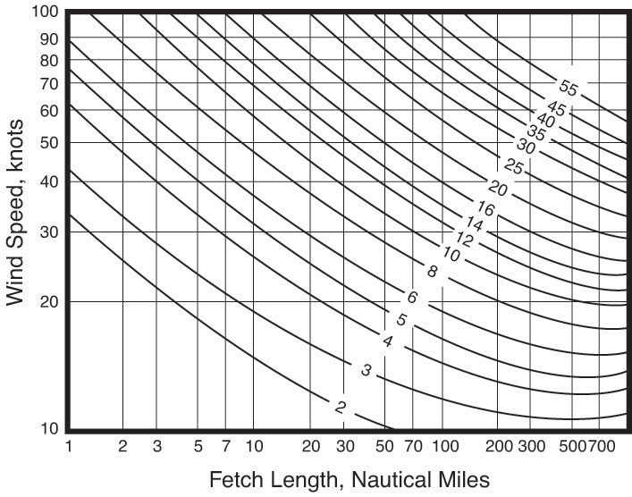
The Wind Drives the Waves

Slide 30
The Effects of Land Morning to Afternoon
Land heats up, air rises, cools, sinks again, wind picks up
Warm air rises over land, cool air from the sea moves inland (sea breeze)

Slide 31
The Effects of Land Evening to Night
Land cools, convection stops, winds die down
Warm air rises from the water, cool air flows down coastal slopes (land breeze)

Slide 32
Forecasting products
What forecasts are available and how to make use of them?

Slide 33
Predicting the Weather
Use multiple sources
Triangulate
Are forecasts in disagreement or changing over time?
Suggests uncertainty in the model. Be cautious.

Slide 34
Day sailing - off your mooring and back
Look at forecast charts
Is there a front coming with a major change in wind and weather?
or are thing stable and so shift attention to detail?
Listen to (or read) the marine weather forecast
Consider your knowledge of the local wind effects
Sea breezes, effects of islands, straights, and channels

Slide 35
NWS Marine Forecast
ANZ200-251300- 717 PM EST SUN JAN 24 2016
.SYNOPSIS FOR MASSACHUSETTS AND RHODE ISLAND COASTAL WATERS... HIGH PRES WILL BUILD OVER THE NATION/S EAST TONIGHT...THEN MOVE OFFSHORE OF THE MID ATLANTIC COAST MON. A WEAK COLD FRONT WILL SLOWLY APPROACH THE FROM THE WEST...PASSING ACROSS THE WATERS WED MORNING. HIGH PRES RETURNS TO NEW ENGLAND WED NIGHT AND THU THEN SHIFTS NE TOWARD THE CANADIAN MARITIMES THU NIGHT. ON ITS HEELS WILL BE AN OCEAN STORM PASSING WELL SE OF NANTUCKET FRI.
ANZ230-251300- BOSTON HARBOR- 717 PM EST SUN JAN 24 2016 TONIGHT NW WINDS 5 TO 10 KT. WAVES 1 FOOT OR LESS... EXCEPT 3 TO 5 FT AT THE OUTER HARBOR ENTRANCE.
MON NW WINDS 5 TO 10 KT...BECOMING W IN THE AFTERNOON. WAVES 1 FOOT OR LESS...EXCEPT 2 TO 4 FT AT THE OUTER HARBOR ENTRANCE.
MON NIGHT S WINDS 5 TO 10 KT. WAVES 1 FOOT OR LESS.
TUE SW WINDS 10 TO 15 KT...INCREASING TO 15 TO 20 KT IN THE AFTERNOON. GUSTS UP TO 30 KT. WAVES AROUND 2 FT.
TUE NIGHT SW WINDS 15 TO 20 KT WITH GUSTS UP TO 30 KT... DIMINISHING TO 10 TO 15 KT WITH GUSTS UP TO 20 KT AFTER MIDNIGHT. WAVES AROUND 2 FT.
WED W WINDS 5 TO 10 KT. WAVES 1 FOOT OR LESS.
WED NIGHT W WINDS 5 TO 10 KT...BECOMING NW AFTER MIDNIGHT. WAVES 1 FOOT OR LESS.
THU E WINDS AROUND 5 KT. WAVES 1 FOOT OR LESS.
THU NIGHT E WINDS 5 TO 10 KT. WAVES 1 FOOT OR LESS. A CHANCE OF SNOW. VSBY 1 TO 3 NM.
FRI N WINDS 5 TO 10 KT. WAVES 1 FOOT OR LESS. A CHANCE OF SNOW AND RAIN. VSBY 1 TO 3 NM.
FRI NIGHT NW WINDS 5 TO 10 KT. WAVES 1 FOOT OR LESS...EXCEPT 2 TO 4 FT AT THE OUTER HARBOR ENTRANCE.
$$

Slide 36
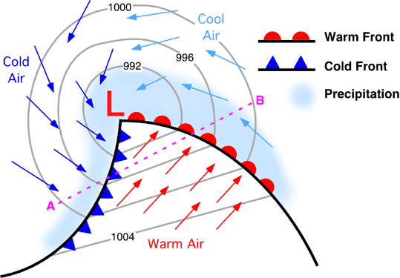
Read the local paper

Slide 37
Coastal sailing for a few days
Hope for the best; plan for the worst
Is it safe now, and is the window opening or closing?
What’s the down side look like?
If the wind shifts, will you be beating all the way home?
What’s “Plan B”?

Slide 38
Sources of Weather Forecasts
National Weather Service Marine Forecast
www.weather.gov/marine
Also available for mobile devices mobile.weather.gov
A long list of government sources for weather
NOAA Weather Radio
WX on your VHF radio
NOAA Weather Fax
Commercial Products
Examples: SailFlow, Buoyweather, Predict Wind, mobileGrib

Slide 39
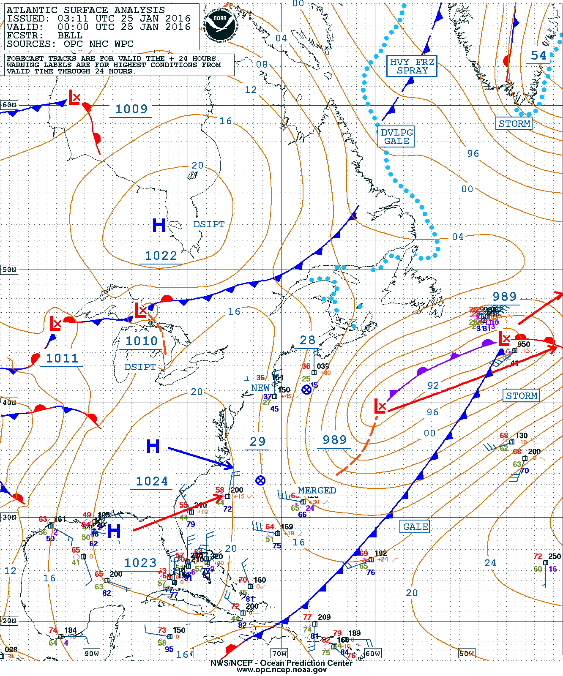
NOAA Weather Fax Surface Charts

Slide 40
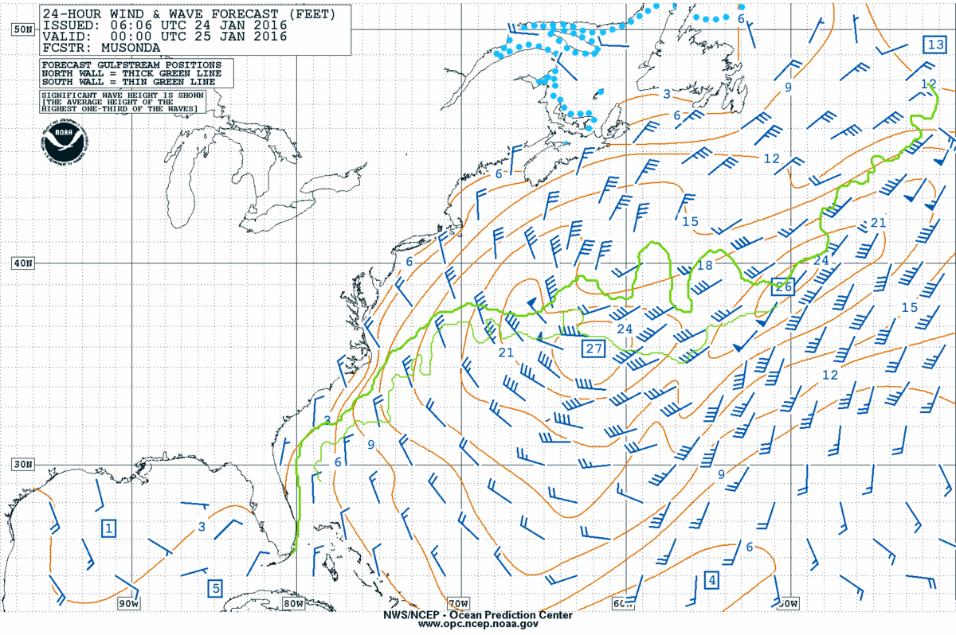
NOAA Weather Fax – Wind/Wave

Slide 41
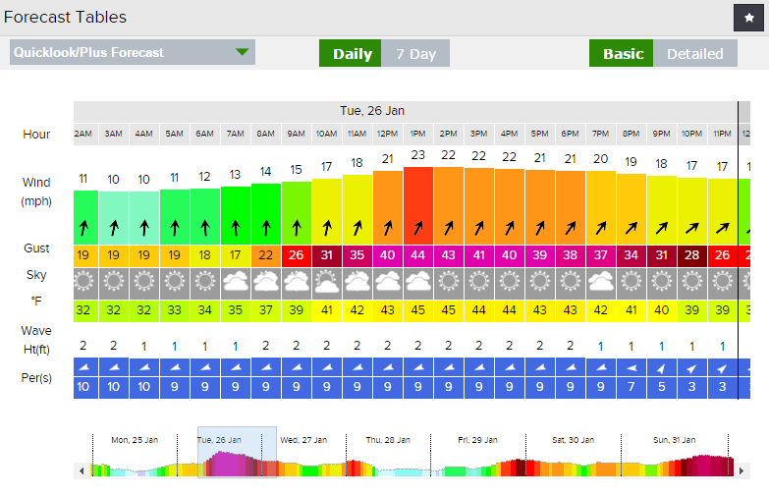
SailFlow http://www.sailflow.com/

Slide 42
Demos

Slide 43
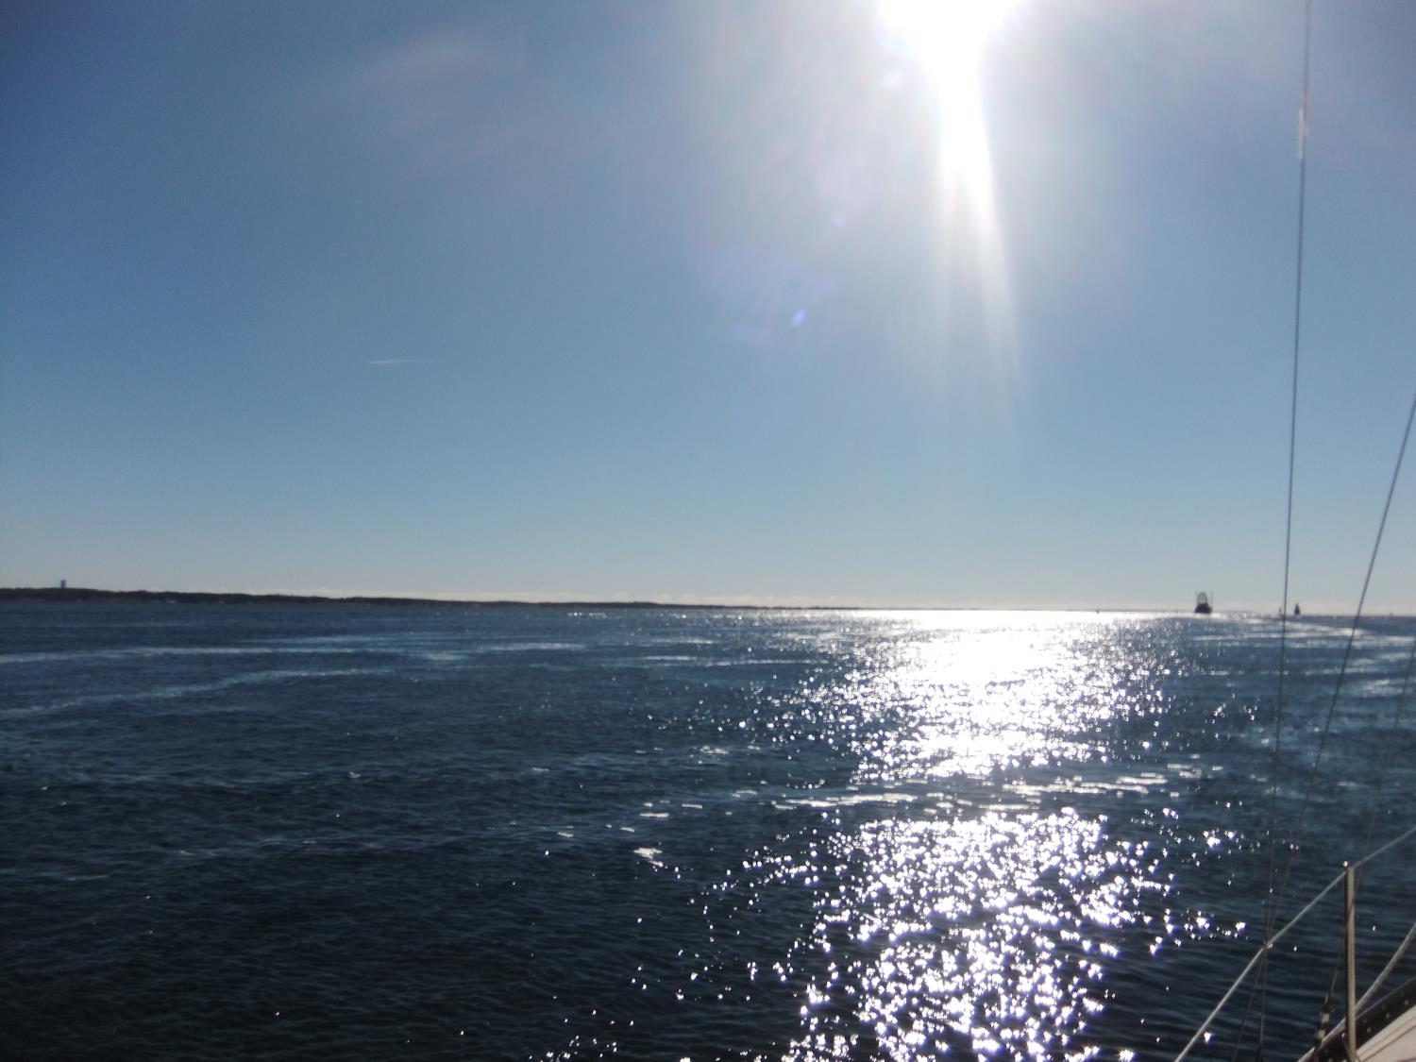
Fair Winds and Following Seas!

