Slide 1
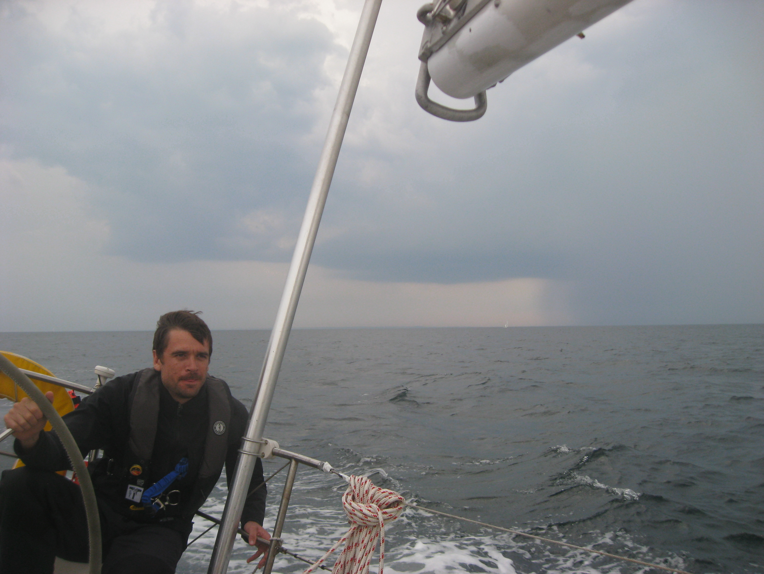
Weather
Eric Brown
MIT IAP 2019
Bluewater Sailing Class

Slide 2
A Practical Overview Of Weather
After this session you should:
Understand what the near-term weather will be from looking at the clouds
Know where to look for detailed weather forecasts, both on land and on the boat
Know the range of applications that will integrate weather predictions for use on a boat
Of necessity we will not go into any topic in detail. There are plenty of sites on the web for further exploration.

Slide 3
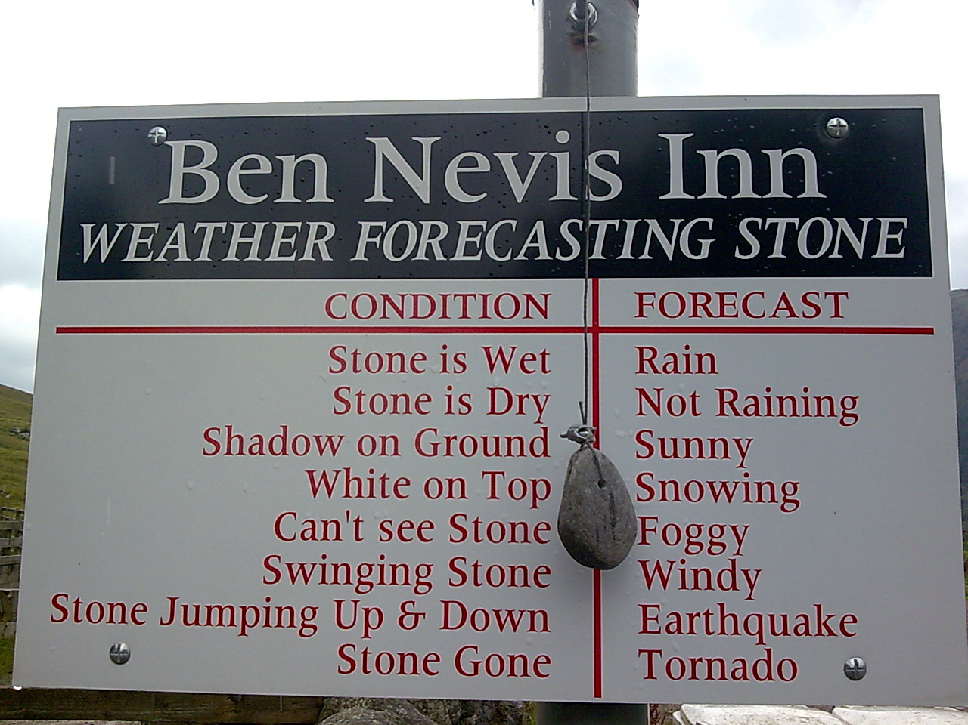

Slide 4
Agenda
Weather Basics
  Where does the weather come from?
  Fronts and air masses
  Cloud types
  Wind, waves, and warnings
Practical forecasting
  What can you tell from looking at the skies and barometer? (pictures, stories)
  Wave heights (wind and fetches) (there’s a standard chart for this)
Forecasting products
  The wide range and uses of forecasting products (NOAA surface and 500 mb, weather radar on your phone, gribs, ???)
  What is available ashore, and how to get them (lots of demos here?)
  What is available onboard (some digging required?)

Slide 5
The Causes of Weather
Atmospheric pressure
The global wind pattern
Wind and weather
Air masses
Atmospheric pressure
Isobars
Dew point (determines bottom of cloud formations, fog, and rain)

Slide 6
The Causes of Weather
Weather is caused by the interactions of air masses that are not in equilibrium – different pressures, temperatures, and moisture content.
Air masses are vast expanses of air that have similar densities, temperatures and moisture and arise from different geographical regions; they move as part of the prevailing winds.
When two dissimilar air masses meet, their boundary is a ‘front’, which is what gives rise to much of the interesting weather.

Slide 7
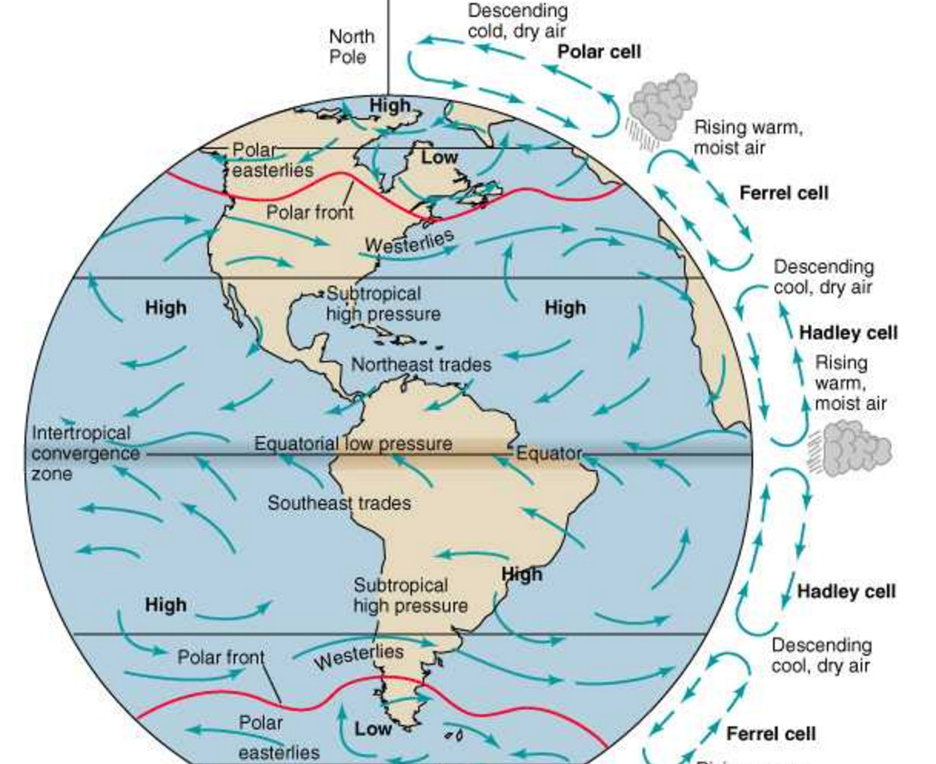
The Causes of Weather – A Macro View
Global Circulation

Slide 8
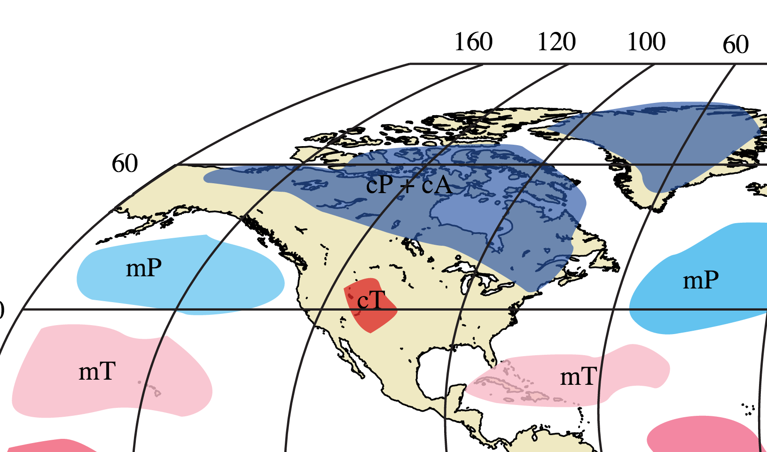
The Causes of Weather
Origin of Air Masses

Slide 9
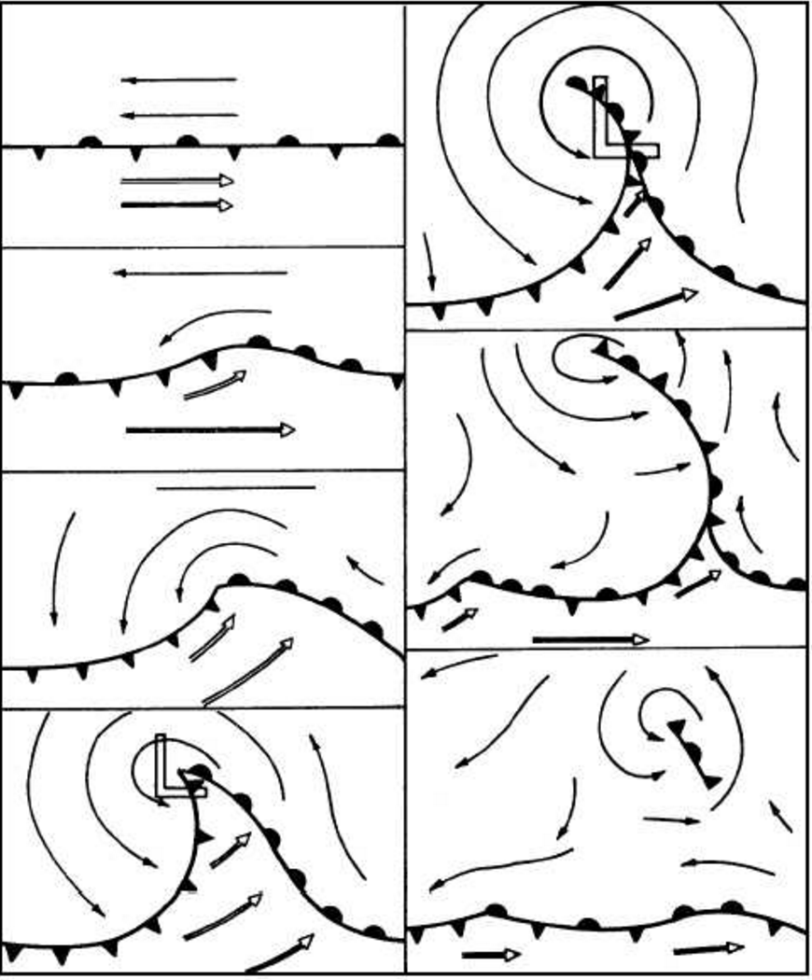
The Causes of Weather
Fronts and Weather Systems Organize Around Highs (H) and Lows (L)

Slide 10
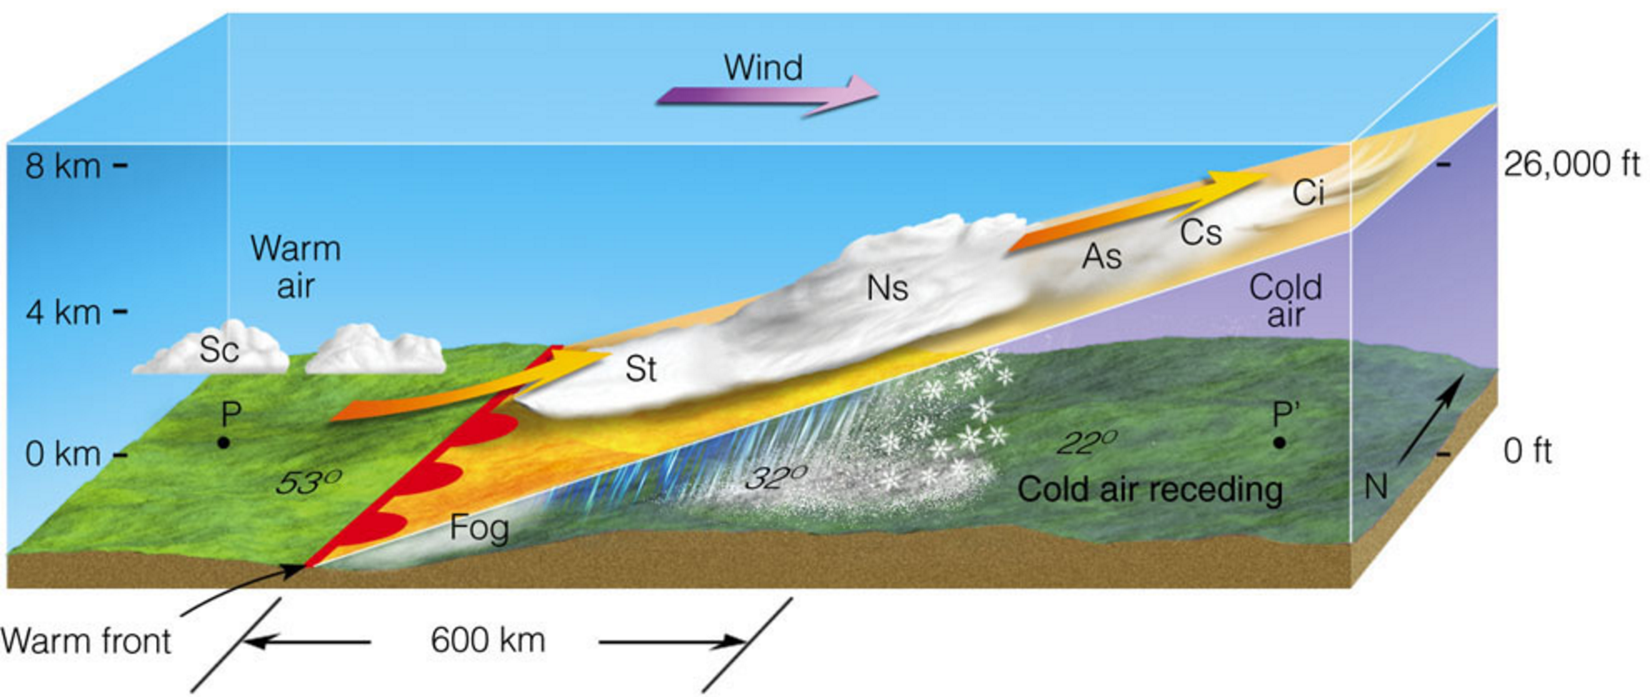
Fronts and Weather Systems
In a Warm Front warm air slides over cold air
Moves slowly 10-15kts
Weather deteriorates gradually
Approaching clouds seen from 1000+ miles
Symbol marking the front is a line with red half circles (warm air is behind the line)

Slide 11
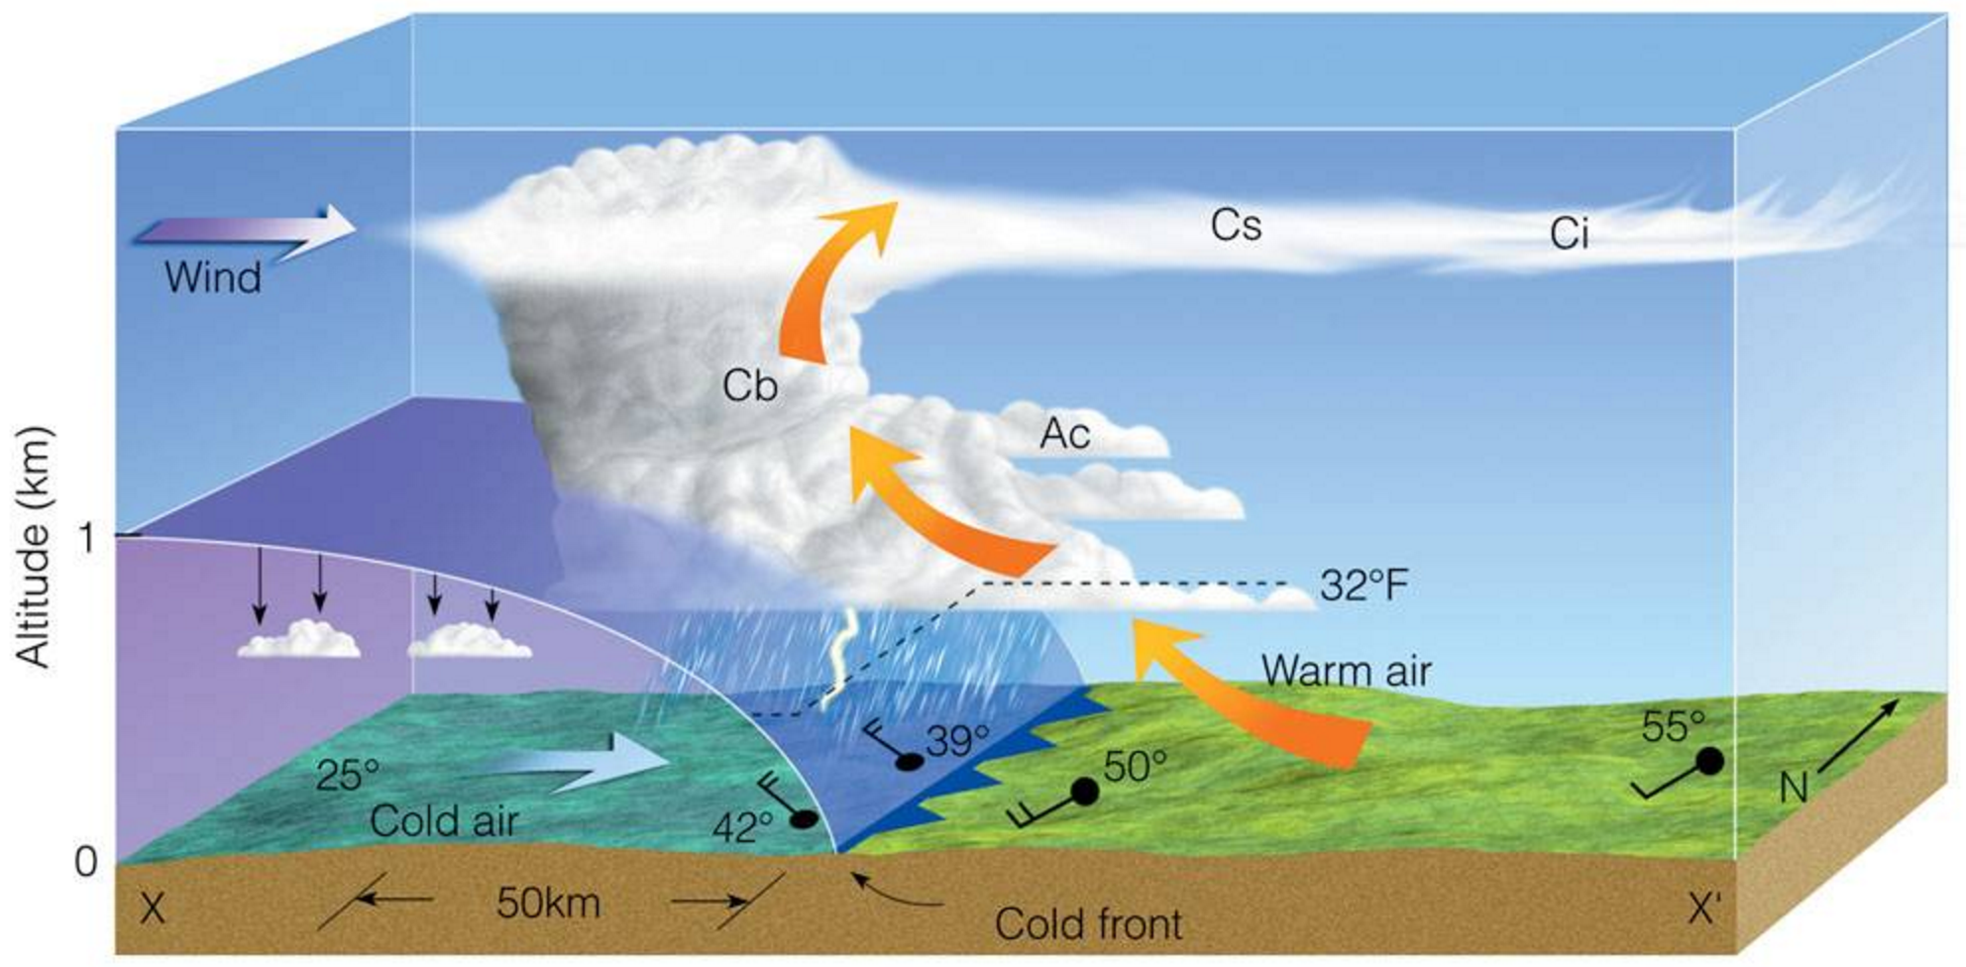
Fronts and Weather Systems
In a Cold Front the Cold Air pushes underneath warm air and causes the air to rise violently and rapidly
– Cold fronts move fast 20- 35 kts
– Generally move E-SE
– Weather deteriorates rapidly
– Approaching clouds seen 50- 150 miles ahead of cold front

Slide 12
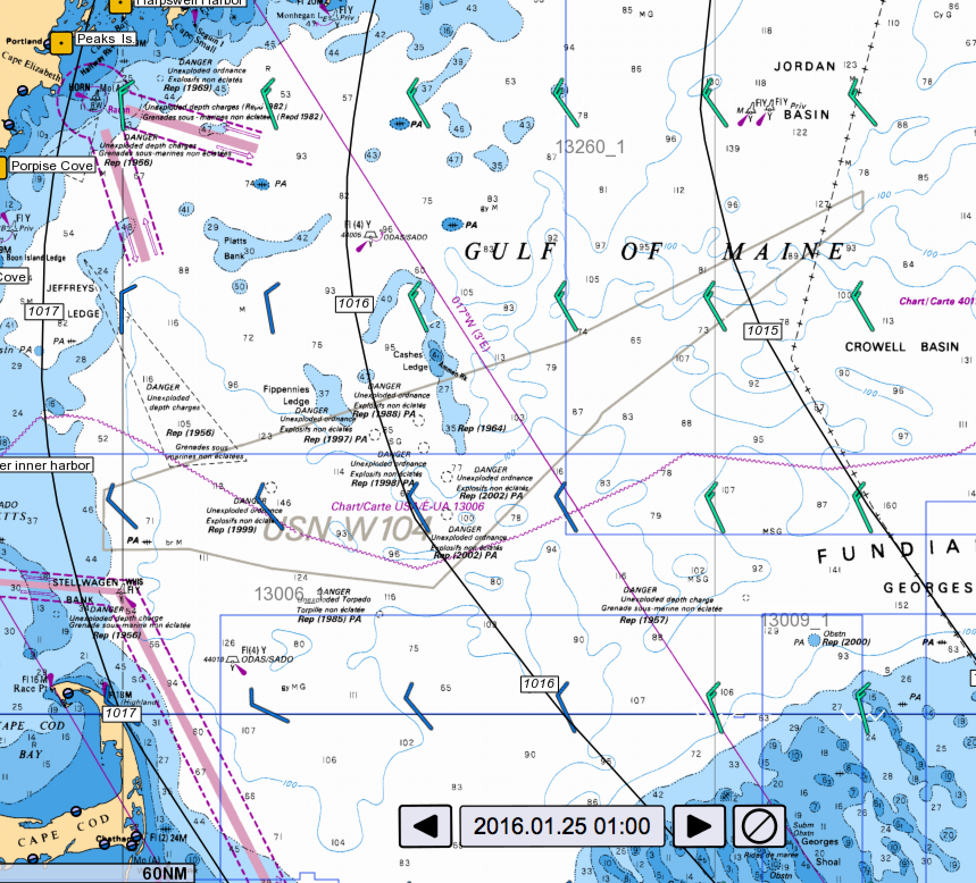
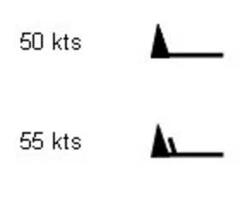
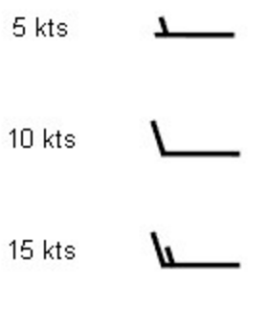
Wind, Waves and Warnings
Wind comes from differences in pressure, and at the surface flows almost along the pressure isobars (due to the Coriolis force).
Direction and speed is represented on charts via a wind barb; the barb ‘points’ in the direction the wind is going.

Slide 13
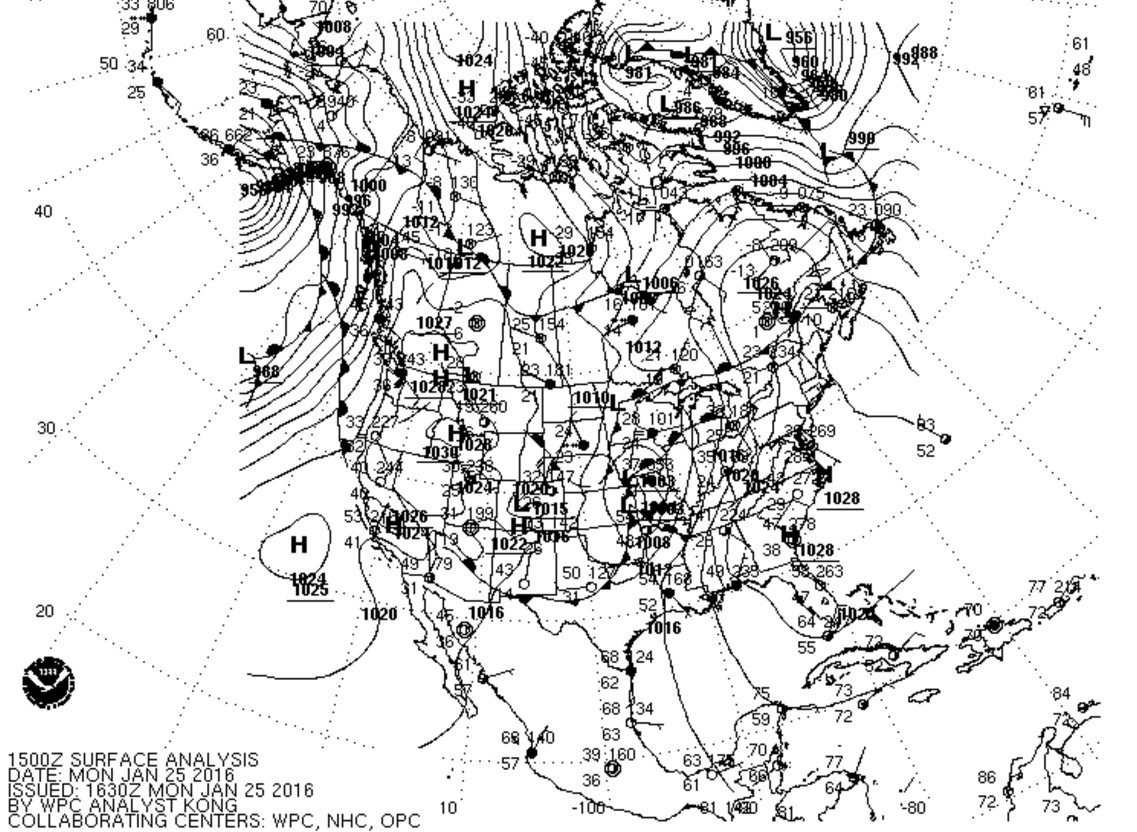
Wind comes from differences in pressure

Slide 14
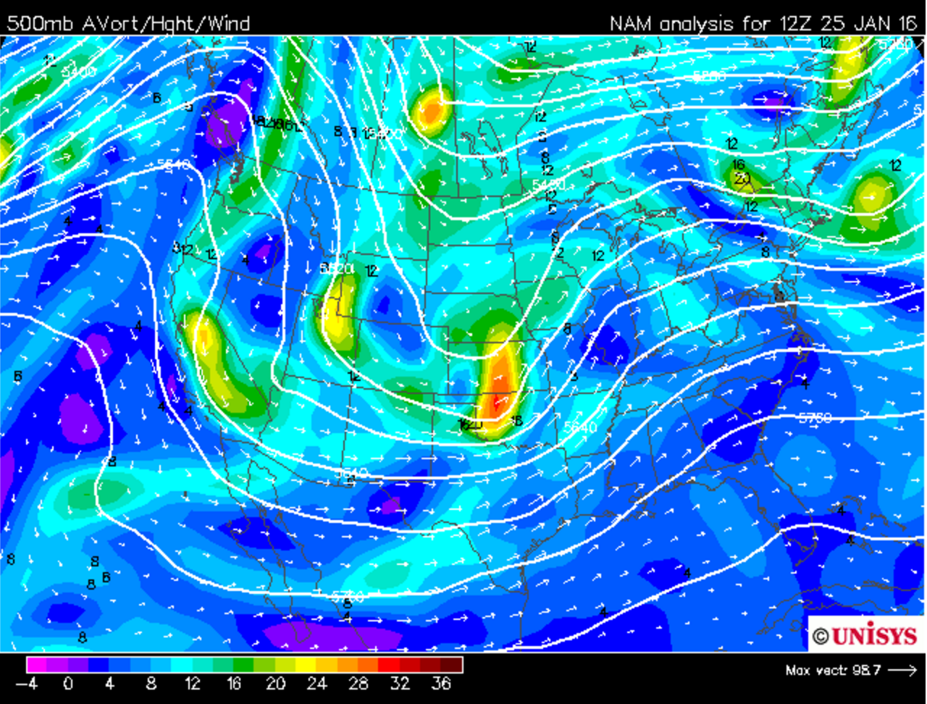
Winds, Waves and Warnings

Slide 15
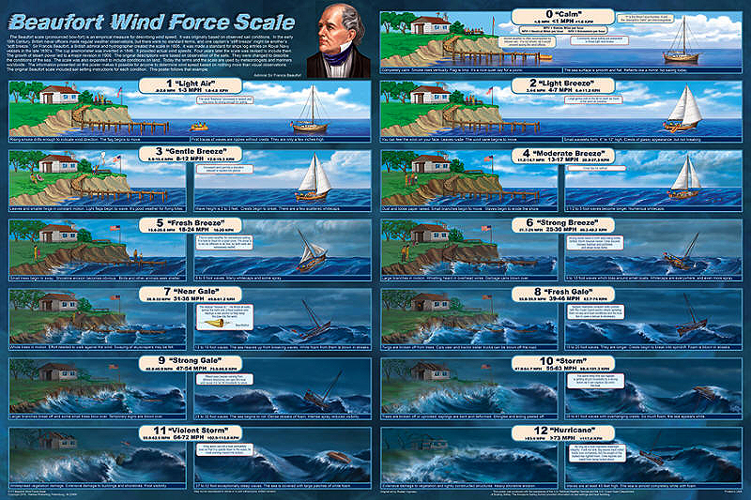

Slide 16
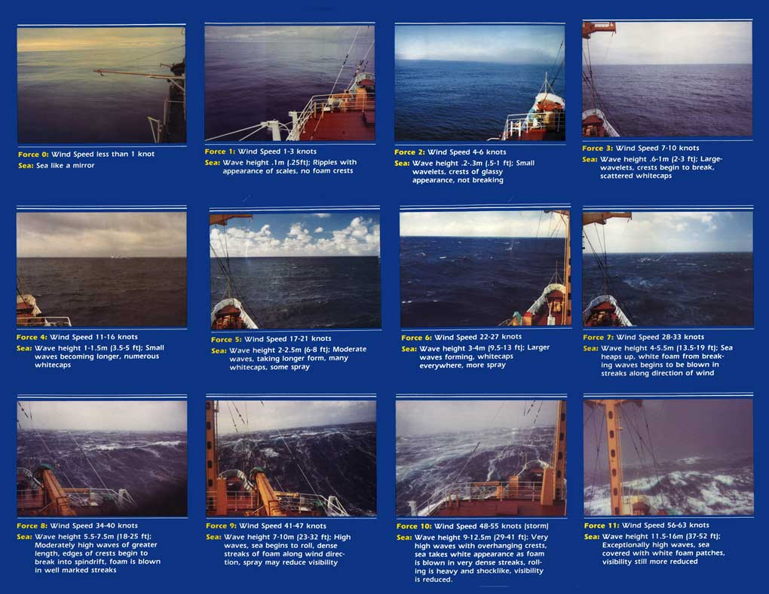

Slide 17
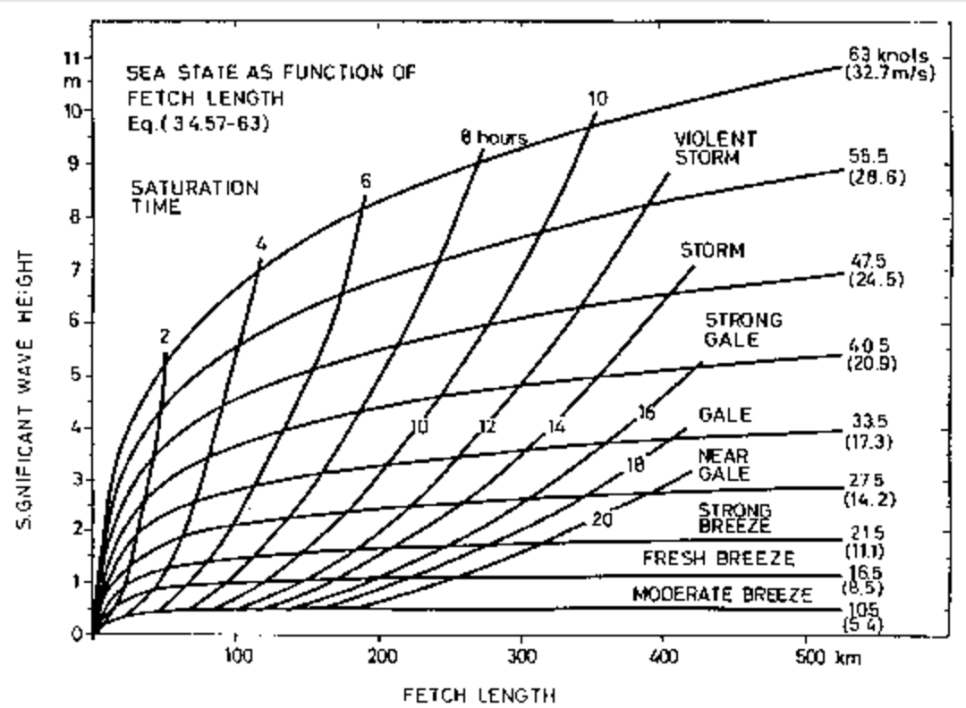
Winds, Waves and Warnings
The greater the wind and the fetch, the higher the wave:

Slide 18
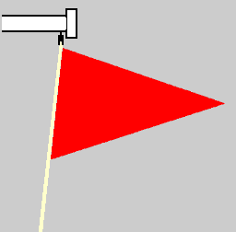
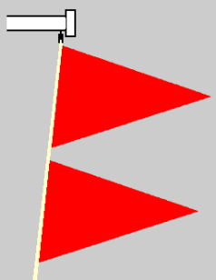
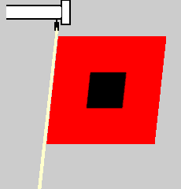
Winds, Waves and Warnings
Warnings
Small craft advisory: forecast winds of 25 kts to 33 kts (no guidance on what a ‘small craft’ is)
Gale warning: forecast winds of 34 kts to 47 kts
Storm warning: forecast winds of 48 kts to 63 kts

Slide 19
Practical forecasting
What can you tell from looking at the skies and barometer?

Slide 20
Reading the Weather
Building cumulus clouds signal wind and storm

Slide 21
Clouds
Stratus: Layered clouds, stable air
  Nimbostratus, Stratocumulus, Altostratus, Cirrostratus, Cirrus (progressively higher altitudes)
Cumulus: Puffy clouds, unstable air
  Cumulonumbus: Thick, tall, puffy clouds (winds)

Slide 22
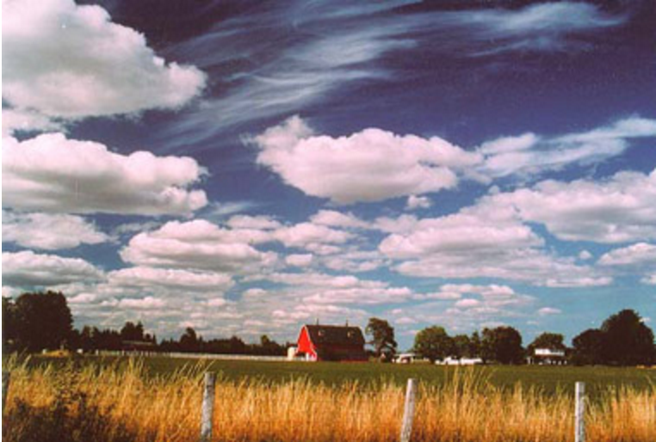

Fronts and Weather Systems
Cloud Types
The basic categorization: shape
Cumulus clouds are puffy
Stratus clouds are flat layers
Cirrus – detached or semi-detached filaments
‘Nimbus’ clouds are associated with precipitation

Slide 23
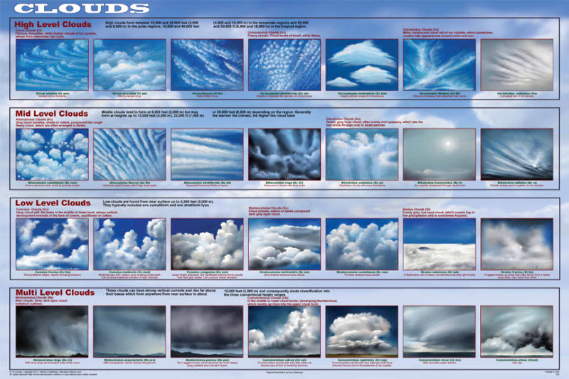

Slide 24

Stratus

Slide 25
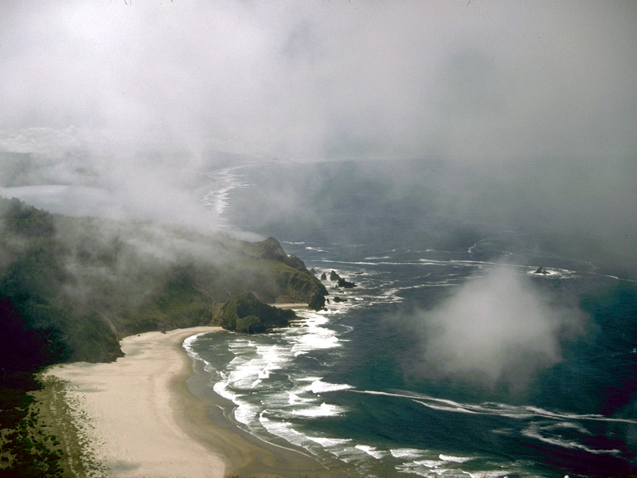
Low-hanging stratus wisps

Slide 26

Classic Altocumulus

Slide 27
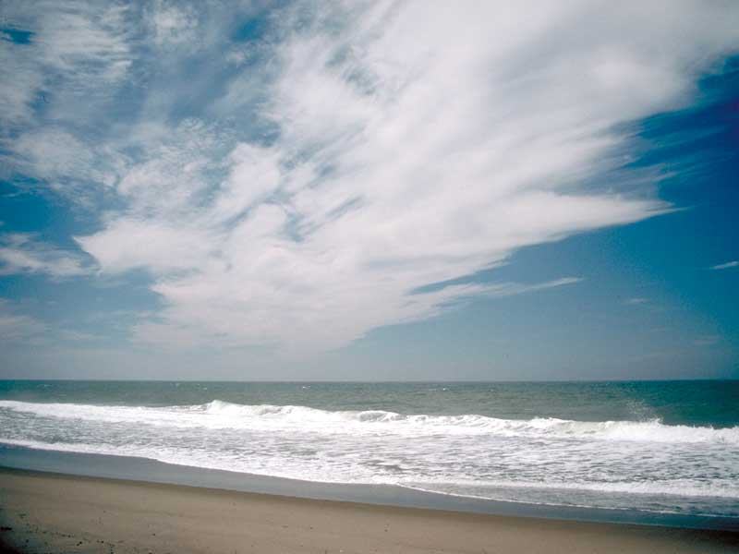
Jet Stream Cirrus

Slide 28
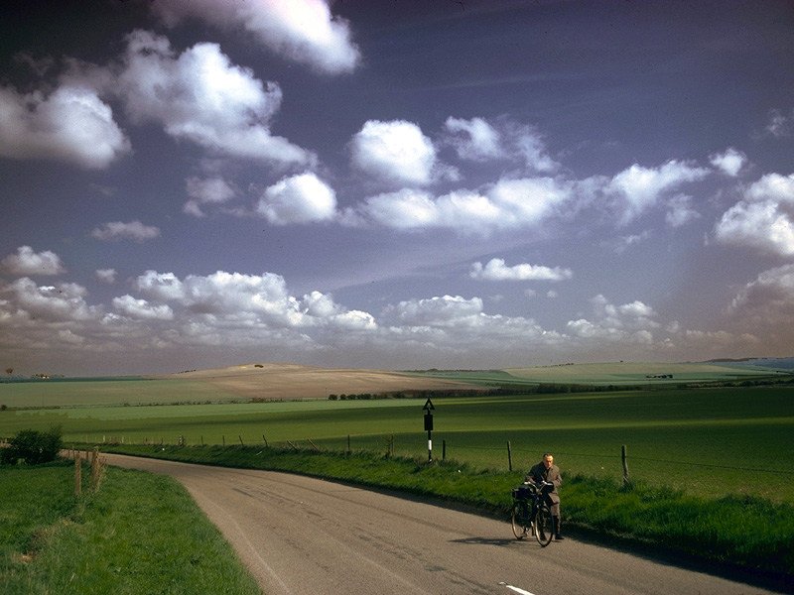
Cumulus of Fair Weather

Slide 29

Cumulus Congestus

Slide 30
Reading the Weather
Building cumulus clouds signal wind and storm
Falling barometer
  Millibars (mb or mbars) typically 1013.25 mbar
  Falling 4 mb in 3 hours, expect winds 20+ knts
  Falling 6 mb in 3 hours, expect gale-force winds!

Slide 31
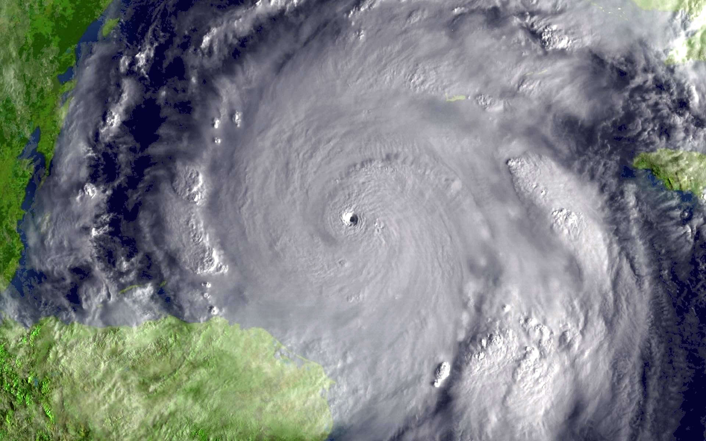
Falling barometer = a Low is coming
Hurricane Wilma (2005)
882 mbar at center!

Slide 32
The Effects of Land
Morning to Afternoon
  Land heats up, air rises, cools, sinks again, wind picks up
  Warm air rises over land, cool air from the sea moves inland (sea breeze)

Slide 33
The Effects of Land
Evening to Night
  Land cools, convection stops, winds die down
  Warm air rises from the water, cool air flows down coastal slopes (land breeze)

Slide 34
Forecasting products
What forecasts are available and how to make use of them?

Slide 35
Predicting the Weather
Use multiple sources
  Triangulate
Are forecasts in disagreement or changing over time?
  Suggests uncertainty in the model. Be cautious.

Slide 36
Day sailing - off your mooring and back
Look at forecast charts
  Is there a front coming with a major change in wind and weather?
  or are thing stable and so shift attention to detail?
Listen to (or read) the marine weather forecast
Consider your knowledge of the local wind effects
  Sea breezes, effects of islands, straights, and channels

Slide 37
NWS Marine Forecast
ANZ200-251300- 717 PM EST SUN JAN 30 2017
Synopsis: A FAST MOVING WAVE OF LOW PRES SYSTEM WILL PASS NEAR THE BENCHMARK THIS AFTERNOON AND EVENING. A WEAK RIDGE OF HIGH PRES WILL BRIEFLY BUILD ACROSS THE WATERS TONIGHT...BEFORE MOVING OFFSHORE ON TUE. LOW PRES WILL APPROACH FROM THE WEST LATE TUE...PASSING NE OF THE WATERS TOWARD NOVA SCOTIA ON WED. A W/NW WIND FOLLOWS THU AND FRI AS HIGH PRES BUILDS E FROM THE NATION/S UPPER MID WEST.
Tonight: NW winds 10 to 15 kt with gusts up to 20 kt. Waves around 2 ft.
Tue: W winds 5 to 10 kt...becoming S in the afternoon. Waves 1 foot or less. Snow.
Tue Night: NE winds 5 to 10 kt. Waves 1 foot or less. Snow. Vsby 1 to 3 nm.
Wed: W winds 5 to 10 kt with gusts up to 25 kt. Waves around 2 ft. A chance of rain and snow showers.
Wed Night: W winds 5 to 10 kt with gusts up to 25 kt. Waves around 2 ft.
Thu: W winds 5 to 10 kt...increasing to 10 to 15 kt in the afternoon. Gusts up to 25 kt. Waves around 2 ft.
Thu Night: W winds 5 to 10 kt with gusts up to 20 kt. Waves around 2 ft.
Fri: W winds 5 to 10 kt with gusts up to 20 kt. Waves around 2 ft.
Fri Night: W winds 5 to 10 kt with gusts up to 20 kt. Waves around 2 ft.
Sat: W winds 10 to 15 kt with gusts up to 25 kt. Waves around 2 ft.
Sat Night: W winds 10 to 15 kt with gusts up to 25 kt. Waves around 2 ft.

Slide 38
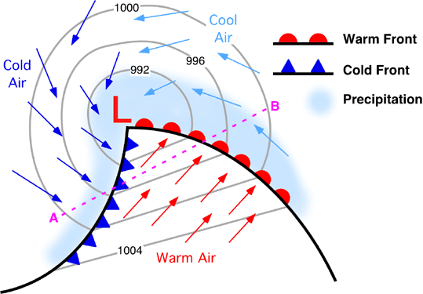
Read the local paper

Slide 39
Coastal sailing for a few days?
Hope for the best; plan for the worst
Is it safe now, and is the window opening or closing?
What’s the down side look like?
  If the wind shifts, will you be beating all the way home?
  What’s “Plan B”?

Slide 40
Sources of Weather Forecasts
National Weather Service Marine Forecast
  www.weather.gov/marine
  Also available for mobile devices mobile.weather.gov
  A long list of government sources for weather
NOAA Weather Radio
  WX on your VHF radio
NOAA Weather Fax
Commercial Products
  Examples: SailFlow, Buoyweather, Predict Wind, mobileGrib

Slide 41
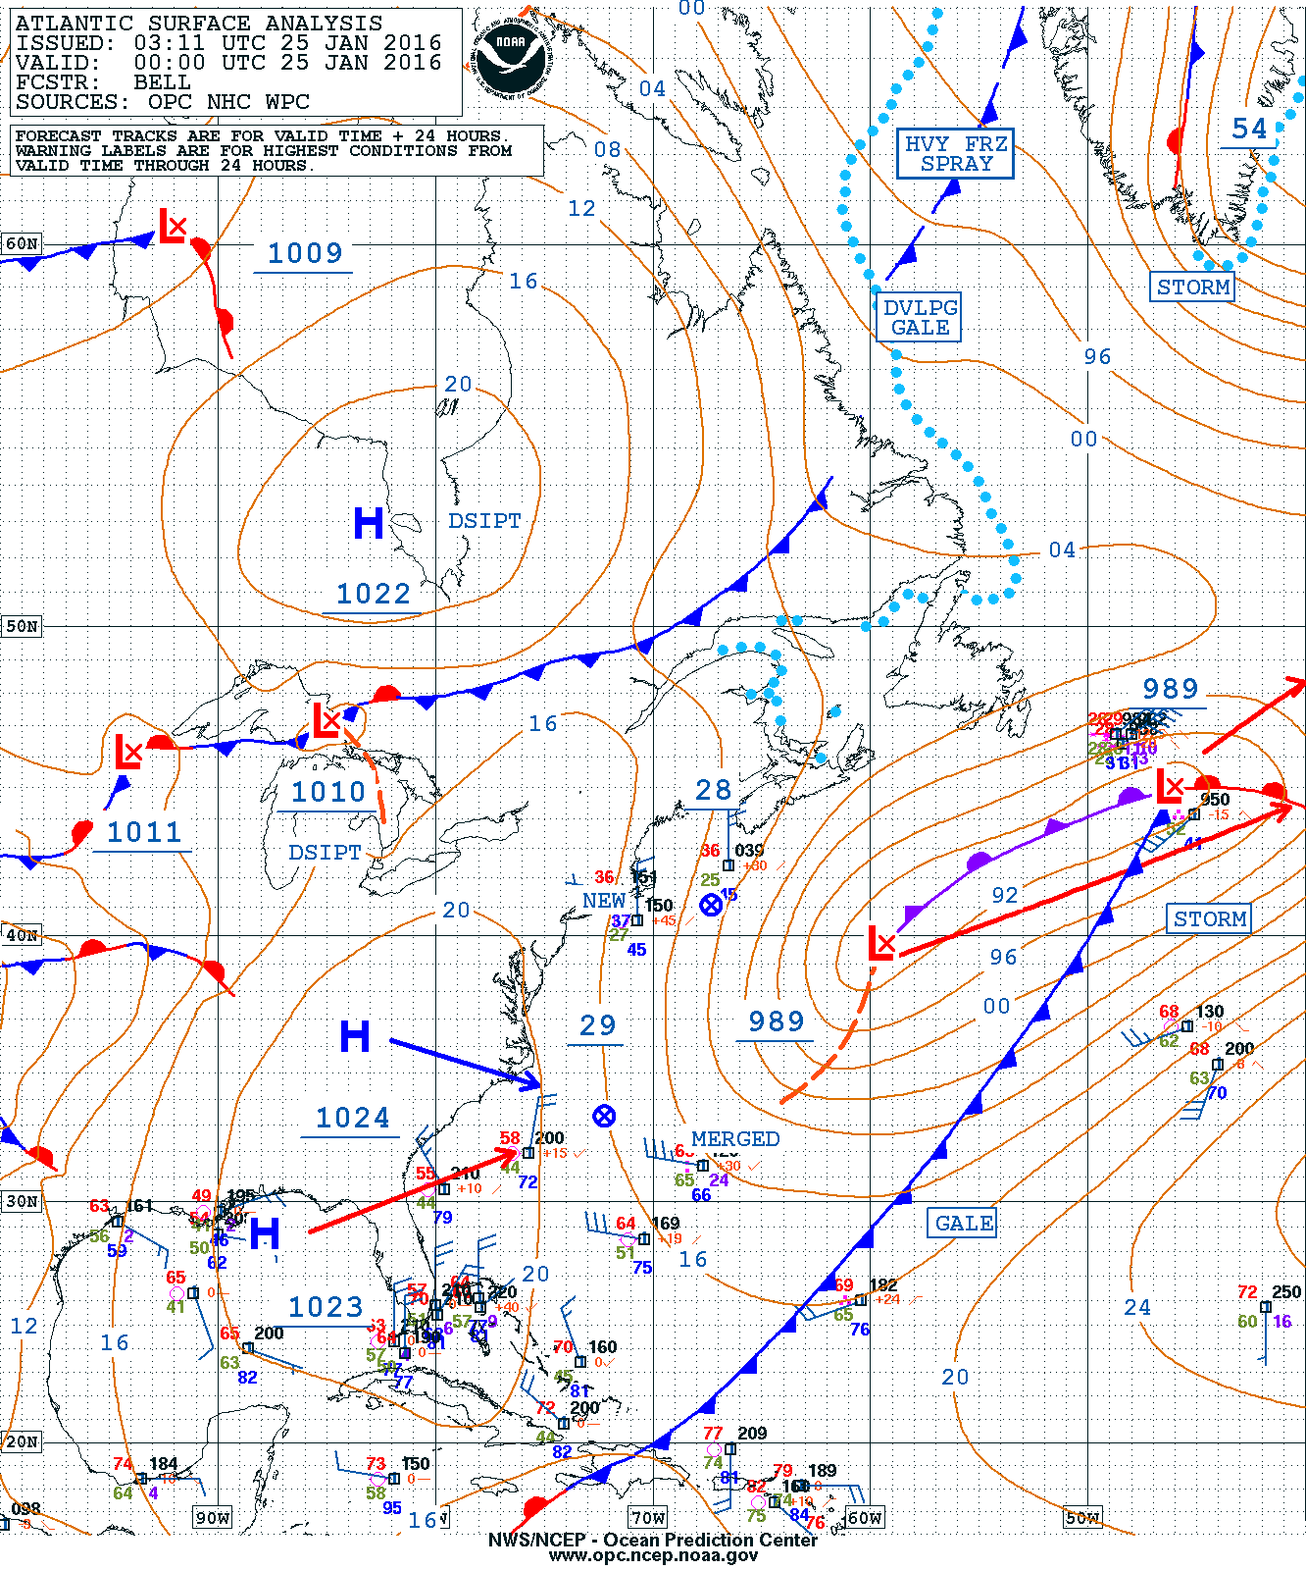
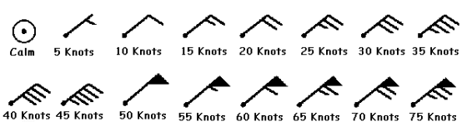
NOAA Weather Fax
Surface Charts

Slide 42
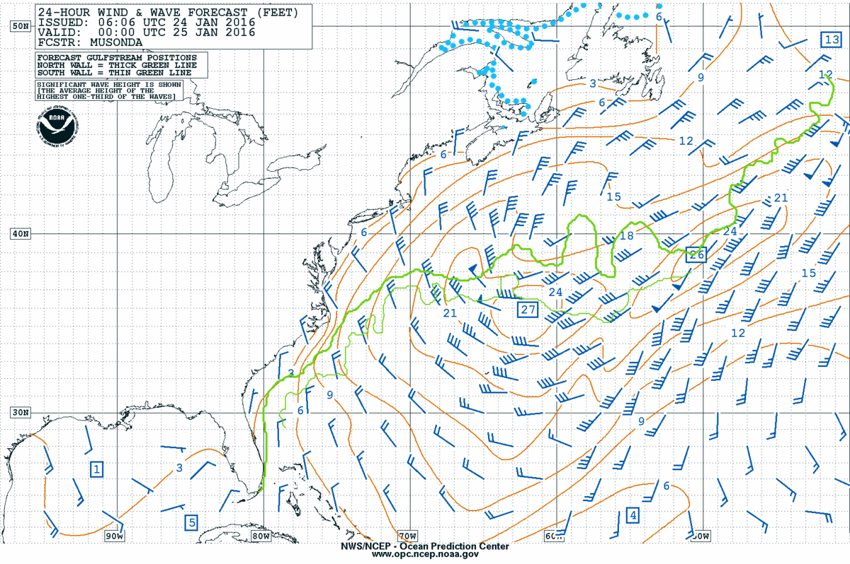
NOAA Weather Fax – Wind/Wave

Slide 43
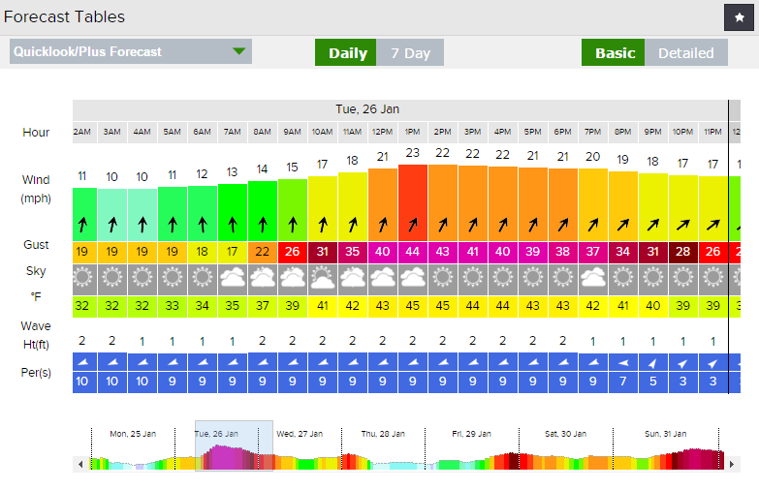
SailFlow http://www.sailflow.com/

Slide 44
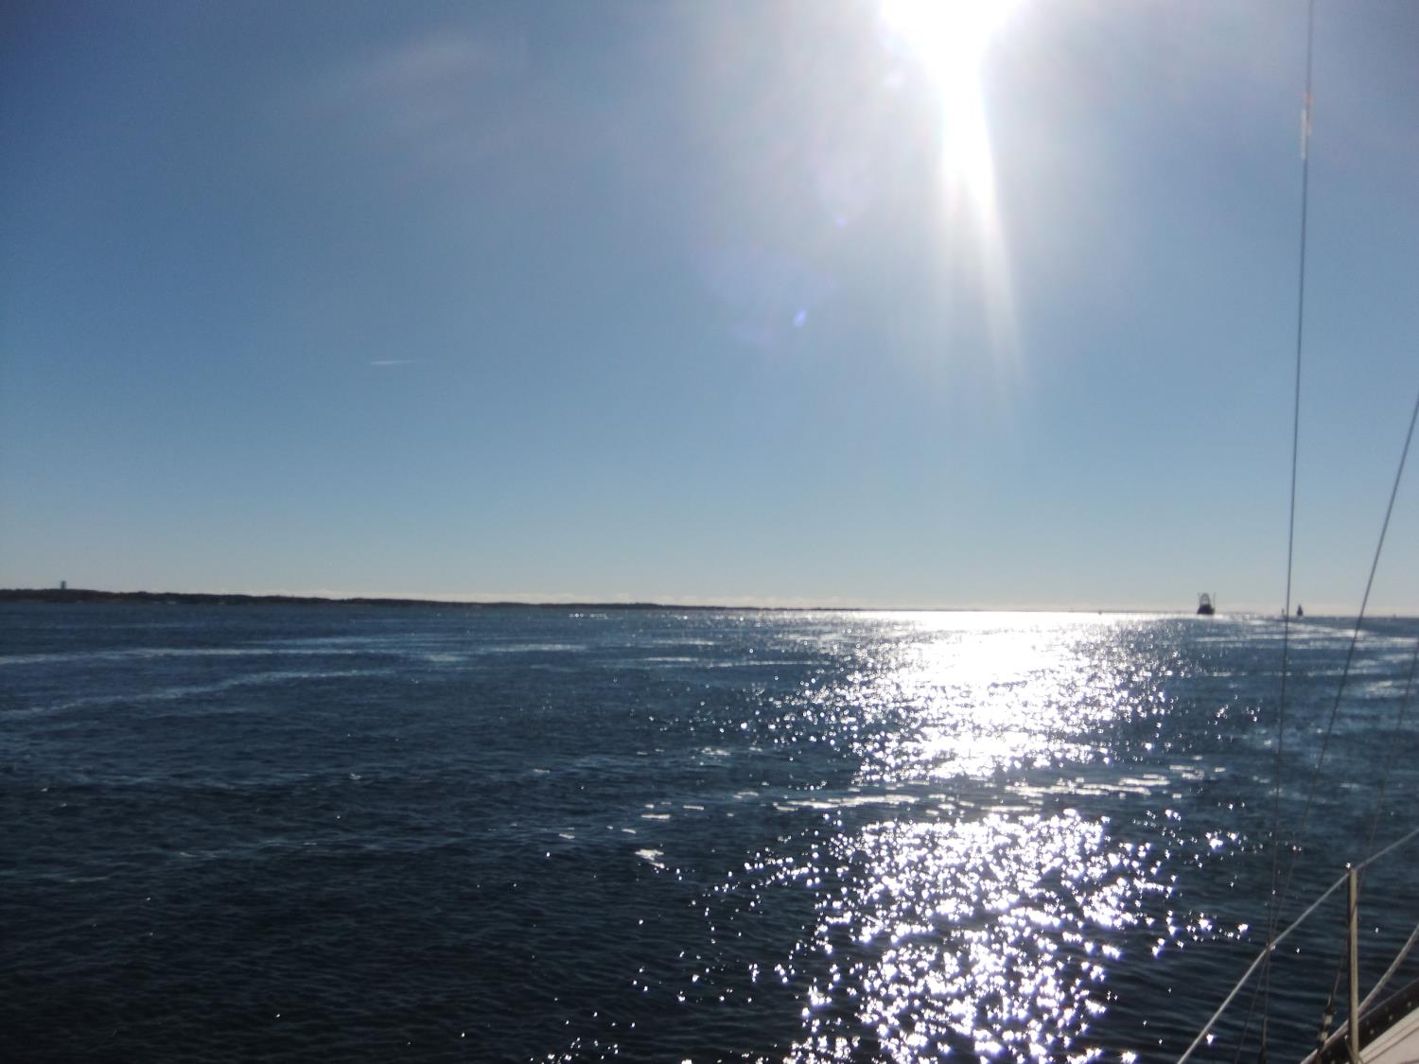
Fair Winds and Following Seas!

