Slide 1
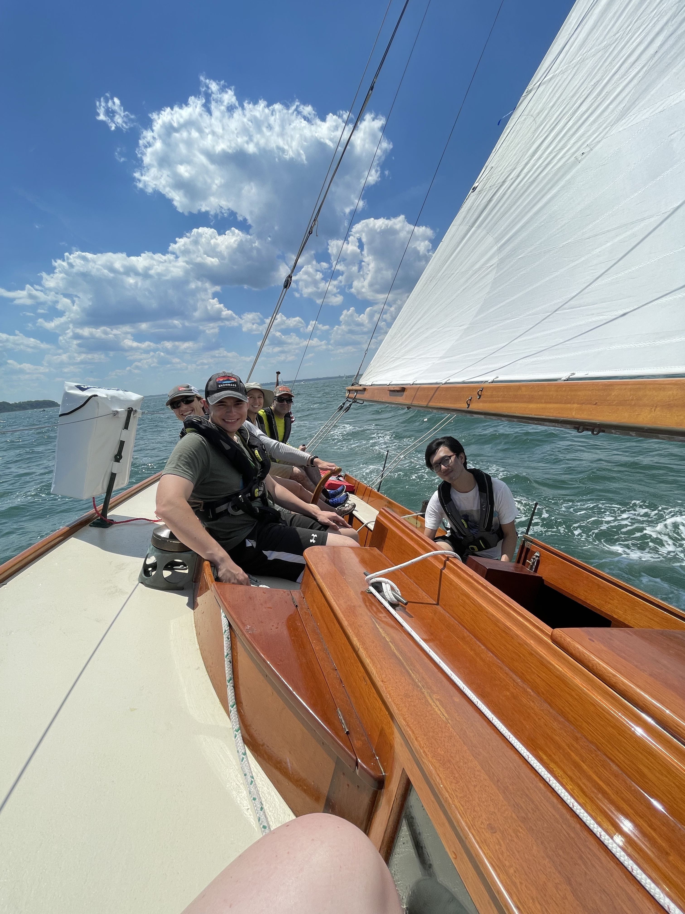
Bluewater Crew Rating
IAP 2023 Session

Slide 2
Bluewater Crew Rating
Rating for sailors with some experience aboard keel boats that would like to build upon their current skills & developing a more advanced skill set
Build the skills and confidence needed to sail on boats outside of MIT
Sailors with Crew Rating are needed on almost all MIT sails
  Evening cruises
  Deliveries
  Full day sails
  Maine
Join the bluewater list if you’re not already

Slide 3
Crew Rating Procedure
Two pathways
New to big boat sailing
  Go out for a few pleasure sails and get some experience
  Ask lots of questions
  Look for “skill sessions” to be offered this spring/summer
Significant big boat sailing experience
  Send your ASA/US Sailing / etc. license to bluewater-skipper@mit.edu and cc me zbz@mit.edu
  Else: take Nauticed Skipper course (see wiki for details/discount code)

Slide 4
Crew Rating Procedure
Once you’ve completed Nauticed course or submitted equivalency: Bluewater crew rating sheet (see wiki)
  Familiarize yourself with the wiki bluewater crew topics
  Two sign-offs needed for each skill: “covered” and “check off”
    Covered is taught to you
    Check off proves mastery — you should be able to do without hesitation and from memory
  Sign up for shore-side sessions to get many topics covered
  Sign up for skill sessions on the water to cover additional topics
  Attend a full-day bluewater crew class to cover the most intensive topics (e.g. MOB, sail handling)
  Attend at least two “pleasure sails” with different skippers to get your check-offs
    Tell the skipper at the beginning about your progress, they can aim to help you get sign-offs

Slide 5
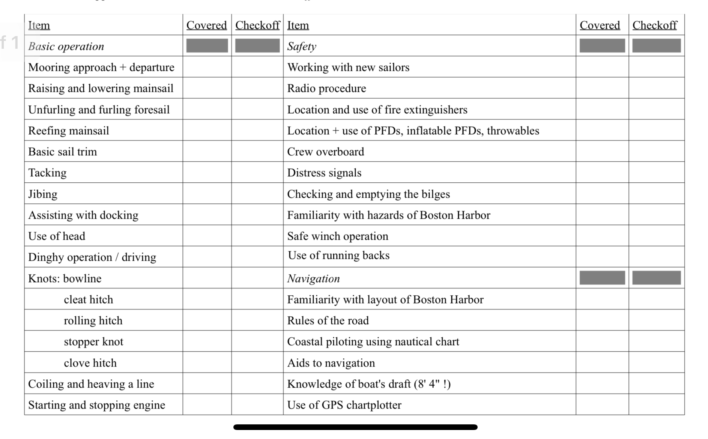
Bluewater crew skills

Slide 6
Knots:
Bowline
Cleat Hitch
Rolling Hitch
Stopper Knot
Clove Hitch
Round Turn Two Half Hitches
Coiling a line

Slide 7
Bowline Knot
The Bowline makes a reasonably secure loop at the end of a line. It has many uses, e.g., to fasten a mooring line to a ring or a post or attaching sheets to a sail. Under load, it does not slip or bind. With no load it can be untied easily. Its principal shortcoming is that it cannot be tied, or untied, when there is a load on the standing end. It should therefore be avoided when, for example, a mooring line may have to be released under load. Bowline

Slide 8
Cleat Hitch
The Cleat Hitch secures a line to a cleat. The cleat can be on the deck, mast, or dock. Care must be taken in certain situations where a locking hitch can cause issues, e.g. large ships, tow lines, or sheeting a sail. We always use a locking hitch aboard Mashnee. However, we don’t lock off the cleat until told to do so when docking. Cleat Hitch

Slide 9
Rolling Hitch
The Rolling Hitch Knot attaches a line (usually smaller) to another (usually larger) when the line of pull is parallel. This knot is useful for transferring the load of a jib during an override or as a snubber for the anchor chain. It is important to note that a rolling hitch will not hold with some modern lines such as Spectra, Dyneema, or Polypropylene. These lines have a slippery outer sheath. Rolling Hitch

Slide 10
Stopper Knot
There are several stopper knots that are acceptable to use. We will focus on using the Double Overhand Stopper Knot (here) and the Figure 8 Stopper Knot (here). These knots are placed at the bitter end of a sheet to prevent the sheet from running free (e.g. Jib sheets, main sheet). NEVER PLACE A STOPPER KNOT ON SPINNAKER SHEETS. A stopper knot in the spinnaker sheets can cause a broach and can potentially lead to injury of crew and / or damage to the boat.

Slide 11
Clove Hitch
Aboard Mashnee, we mainly use the Clove Hitch to secure the tiller in the center position (here or here). The Clove Hitch is known to slip and bind, so it is recommended that you add half hitches to stop slipping. While the clove hitch can be used to secure a fender to the life lines, a better option would be to use a Round Turn & 2 Half Hitches.

Slide 12
Coiling a Line
Every time we finish a sail, we neaten up the lines on Mashnee by coiling them
Every time we leave the dock, we coil the dock lines
Coiling lines: braided vs. non-braided
Coiling a line

Slide 13
Radio Procedures
Crew members should be comfortable using the VHF for both emergency and non emergency transmissions
    Mayday
    Harbor Master
    Marina
    Fuel Dock
Comfort with using the VHF is a matter of practice

Slide 14
Radio Procedures - DOs & DON’Ts
DO…
Talk clearly & slowly
Follow directions of USCG
Use appropriate VHF channels
Keep transmissions focused
DON’T
Yell into microphone
Say COPY after transmission
Foul language / Argue
Radio check request

Slide 15
Radio Procedures
For Non - Emergency transmissions…
Identify Boat, marina, dock 3 times
Identify who you are 1 -3 times
State request
Standby for response

Slide 16
Radio Procedures
Fuel dock, fuel dock, fuel dock….
This is S/V MASHNEE
We are requesting permission to proceed with docking with a port tie up

Slide 17
Safety
Handheld flare (Day/Night) x3
Day Use distress flag (Orange with black circle and black square)
Night use distress light (automatic)
3x B-I Fire Extinguishers
At least one USCG-approved Type I, II, III, or V PFD for each person aboard
  i.e. not the spinlocks

Slide 18
Radio Operations - Mayday
The following protocol is for a MAYDAY call. Use this protocol if there is risk of loss of life. If in doubt, make the MAYDAY call, it can be canceled.
Tune the VHF radio to channel 16.
Distress signal "MAYDAY", spoken three times.
The words "THIS IS", spoken once.
Name of vessel in distress (spoken three times).
Repeat "MAYDAY" and the name of the vessel, spoken once.
Give position of vessel by latitude or longitude or by bearing (true or magnetic, state which) and distance to a well-known landmark such as a navigational aid or small island, or in any terms which will assist a responding station in locating the vessel in distress. Include any information on vessel movement such as course, speed and destination.
Nature of distress (sinking, fire etc.).
Kind of assistance desired.
Number of persons onboard.
Any other information which might facilitate rescue, such as length or tonnage of vessel, number of persons needing medical attention, color hull, cabin, masks, etc.
The word "OVER"

Slide 19
Harbor Navigational Hazards

Slide 20
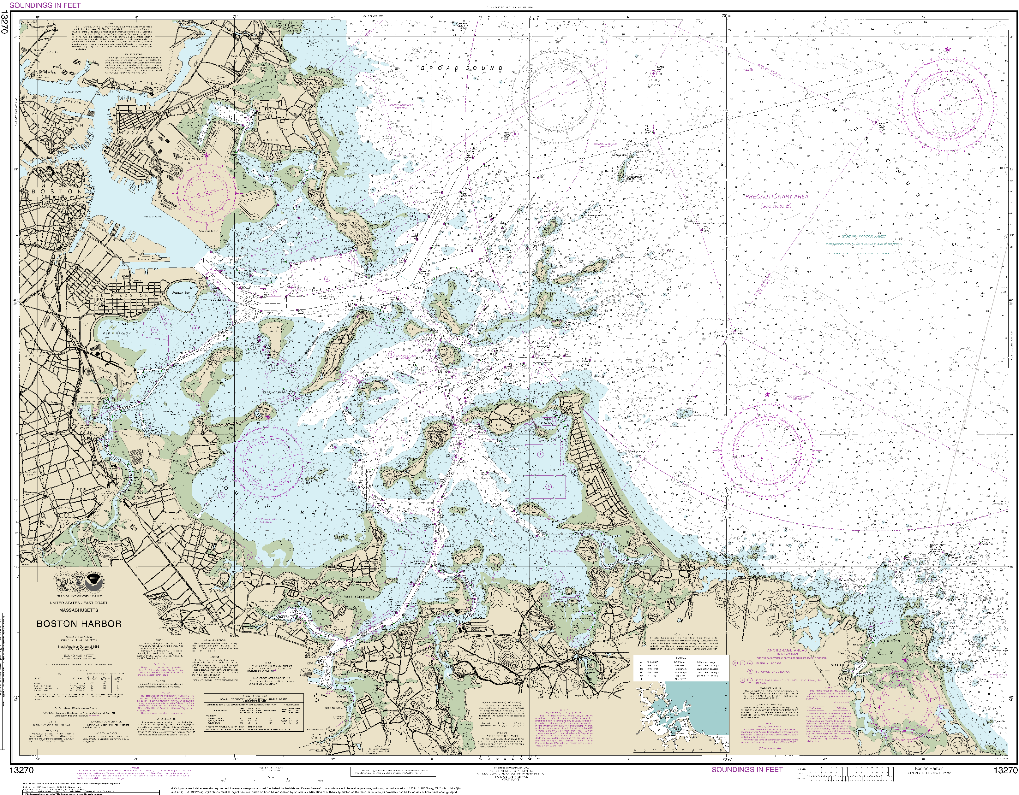

Slide 21
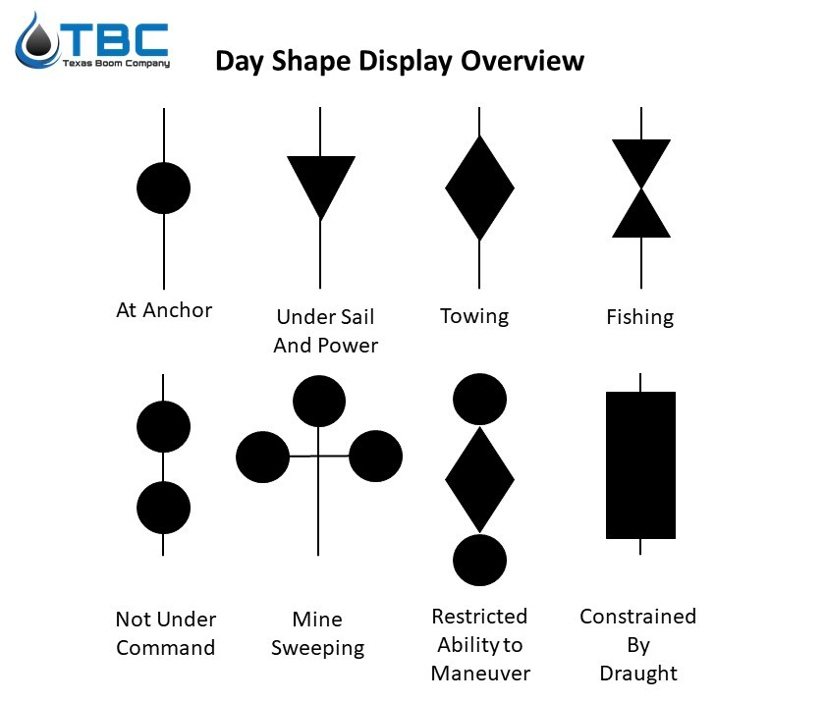
Navigation Lights & Shapes
Sailing Vessel underway under sail (night)
  Red (port) & Green (starboard) sidelightas visible for at least 2 nm
  White stern light visible for 2nm
  OR: white, red, green tricolor light at the top of the mast visible for 2nm
    Cannot be used in conjunction with sidelights and stern light
Sailboat underway under power (night)
    Red & green sidelights
    White stern light
    White forward masthead light (steaming light)
Sailboat underway under sail and engine (Day)
  Conical day shape, apex downward
At anchor
  All-round white light at masthead (night)
  Round black ball (day)

Slide 22
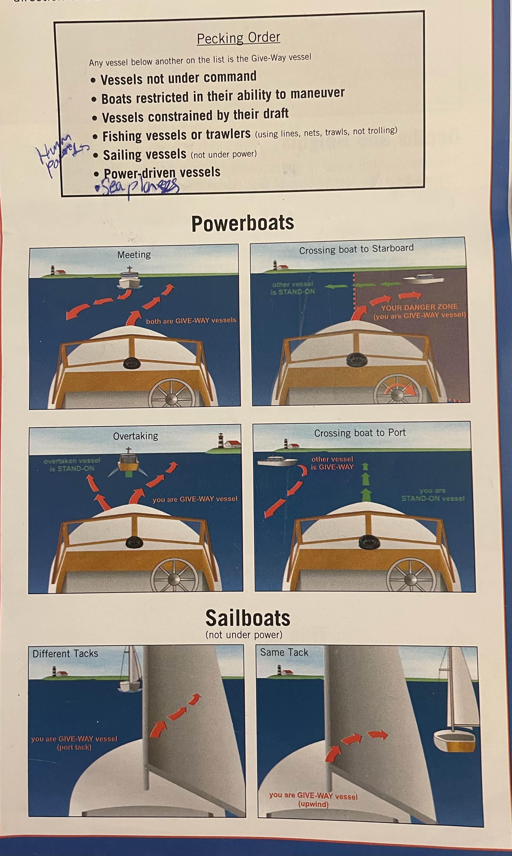
Rules of the Road

Slide 23
Sounds Signals
One short (pass you on my port)
Two Short (pass you on my starboard)
Three short: backing
Five short: danger
One long: entering or exiting blind area; leaving dock/berth
Whistle audible for 0.5nm
  Under power in restricted visibility: one prolonged blast every two minutes
  Under sail in restricted visibility: one long, two short every two minutes

Slide 24
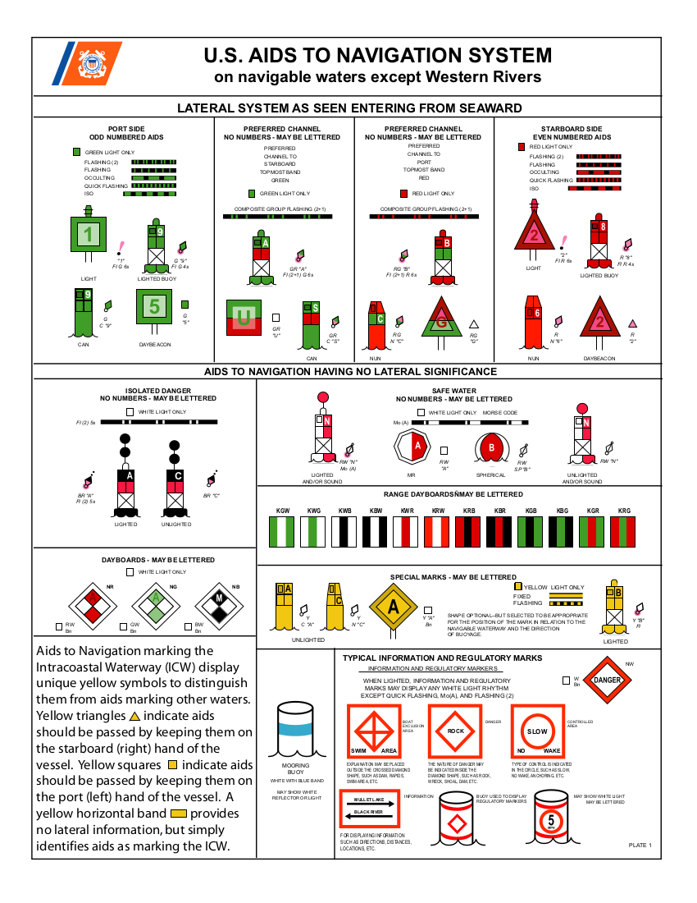
Aids to Navigation
Notes:
Beacon
Daybeacon
Daymark
Bouy
Can bouy
Nun bouy
Lighted beacon
Lighted bouy
FL: flashing: light shorter than dark, time is how long between each (dark) 3
ISO: isophae (equal periods light and dark)
Of: period of light longer than dark
Group: light or dark grouped into period

Slide 25
Wrap-Up
What did you learn new tonight?

